Slide 1
MICROPROCESSORS AND MICROCONTROLLERS (BECE204L)
Dr. Satheesh Kumar S
Assistant Professor Sr. Gr2
School of Electronics Engineering
1

Slide 2
Module 3:
Microcontroller Architecture: Intel 8051
Microcontroller 8051 - Organization and Architecture, RAM-ROM Organization, Machine Cycle, Instruction set: Addressing modes, Data Processing - Stack, Arithmetic, Logical; Branching – Unconditional and Conditional, Assembly programming.
References:
Muhammed Ali Mazidi, Janice GillispieMazidi ,Rolin D Mc Kinlay ,The 8051 Microcontroller and Embedded Systems Using Assembly and C , Second Edition ,2008 , Pearson Education
The 8051 microcontroller : architecture, programming, and applications, Kenneth J. Ayala
Course Outcomes:
CO3: Comprehend the architectures and programming of 8051 microcontroller.
2

Slide 3
Microprocessor vs Microcontroller?
Microprocessor
A microprocessor is also known as a central processing unit in which numbers of peripherals’ are fabricated on a single chip. It has ALU (arithmetic and logic unit), a control unit, registers, bus systems and a clock to perform computational tasks.
Microprocessors are not made for a specific task as well as they are useful where tasks are complex and tricky like the development of software, games, and other applications that require high memory and where input and output are not defined.
Ex: A) Household devices: Complex home security, Home computers, Video game systems and many more.
B) Transportation and Industrial Devices: Automobiles, trains, planes, Computer servers, high tech medical devices, etc.

Slide 4
Microcontroller
The microcontroller is designed for a specific task or to perform the assigned task repeatedly. Once the program is embedded on a microcontroller chip, it can’t be altered easily and you may need some special tools to reburn it.
As per application, the process is fixed in microcontroller. Hence, the output depends on the input given by the user or sensors or predefined inputs.
Ex: Calculator, Washing Machine, ATM machine, Robotic Arm, Camera, Printer, Microwave oven, Oscilloscope, Digital multimeter, ECG Machine, etc.

Slide 5
A microcontroller is a small and low-cost microcomputer, which is designed to perform the specific tasks of embedded systems like displaying microwave’s information, receiving remote signals, etc.
The general microcontroller consists of the processor, the memory (RAM, ROM, EPROM), Serial ports, peripherals (timers, counters).
29

Slide 6
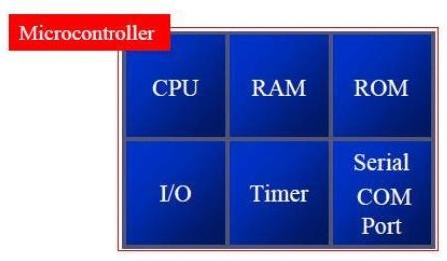
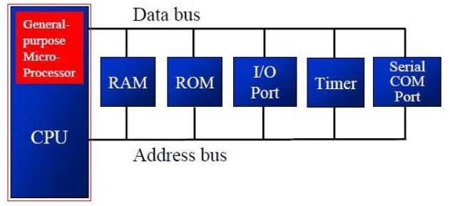
Differences Between Microprocessor And Microcontroller
MICROPROCESSOR | MICROCONTROLLER
1. | 1.
2.Microprocessor is the heart of computer system | 2.Microcontroller is the heart of embedded system
3.It is just a processor. Memory and I/O components has to be connected externally | 3.Microcontroller has external processor along with internal memory and i/o components. 30

Slide 7
Differences Between Microprocessor And Microcontroller
MICROPROCESSOR | MICROCONTROLLER
4.Cannot be used in compact systems and inefficient | 4.Can be used in compact systems and hence efficient
5.Cost of the entire system increases | 5.Cost of the entire system is low
6.Due to external components the entire power consumption is high | 6.Since external components are low the entire power consumption is less.
7.Since memory and i/o components are all external each instruction will need external operation. Hence it is relatively slower | 7.Since components are internal most of the operations are internal instruction, Hence speed is fast
8.Microprocessor has less number of registers hence most of the operations are memory based. | 8.Microcontroller has more number of registers hence the programs are easier to write.
31

Slide 8
Differences Between Microprocessor And Microcontroller
MICROPROCESSOR | MICROCONTROLLER
9.Microprocessors are based on Von Neumann Architecture, where program and data are stored in same memory module. | 9.Microcontrollers are based on Harvard Architecture where program and data are separate.
10. Microprocessors are used for big applications. | 10. Microcontrollers are used to execute a single task within an application.
11. It doesn’t consist of RAM, ROM, I/O ports. It uses its pins to interface to peripheral devices. | 11.It consists of CPU, RAM, ROM, I/O ports.
12.Mainly used in personal computers | 12.Used in Washing machines,MP3 players.

Slide 9






Advantages of Microcontroller based System
As the peripherals are integrated into a single chip, the overall system
As the peripherals are integrated with a microprocessor the system is more reliable.
Though microcontroller may have on chip ROM,RAM and I/O ports, addition ROM, RAM I/O ports may be interfaced externally if required.
On chip ROM provide a

Slide 10
Why/how we choose a Microcontroller
Three criteria in Choosing a Microcontroller:
Meeting the computing needs of the task efficiently and cost effectively.
speed, the amount of ROM and RAM, the number of I/O ports and timers, size, packaging, power consumption.
easy to upgrade.
cost per unit.
Noise of environment.
Availability of software development tools
assemblers, debuggers, C compilers, emulator, simulator, support
3. Wide availability and reliable sources of the microcontrollers
technical

Slide 11
Types of Microcontrollers
Microcontrollers are divided into various categories based on bits, memory, architecture and instruction sets.
Based on bits: 8-bit, 16-bit, 32-bit
Based on memory: External memory microcontroller, Embedded memory microcontroller
Based on instruction set: CISC, RISC

Slide 12
Types of Microcontrollers
Based on bits:
8-bit microcontroller
This type of microcontroller is used to execute arithmetic and logical operations like addition, subtraction, multiplication division, etc.
For example, Intel 8031 and 8051 are 8 bits microcontroller.

Slide 13
16-bit microcontroller
This type of microcontroller is used to perform arithmetic and logical operations where higher accuracy and performance is required.
For example, Intel 8096 is a 16-bit microcontroller.
32-bit microcontroller
This type of microcontroller is generally used in automatically controlled appliances like automatic operational machines, medical appliances, etc.

Slide 14
Based on memory:
External memory microcontroller
This type of microcontroller is designed in such a way that they do not have a program memory on the chip.
Hence, it is named as external memory microcontroller.
For example: Intel 8031 microcontroller.
Embedded memory microcontroller
This type of microcontroller is designed in such a way that the microcontroller has all programs and data memory, counters and timers, interrupts, I/O ports are embedded on the chip.
For example: Intel 8051 microcontroller.

Slide 15
Based on instruction set:
CISC
CISC stands for Complex Instruction Set Computer.
It allows the user to insert a single instruction as an alternative to many simple instructions.
Ex: JZ TEMP - if the number in the accumulator is not 0, jump to the address marked as TEMP; ADD A,R3 - add R3 and accumulator; CJNE A,#20,LOOP - compare accumulator with 20. If they are not equal, jump to the address marked as LOOP;
RISC
RISC stands for Reduced Instruction Set Computers.
It reduces the operational time by shortening the clock cycle per instruction.

Slide 16
Basic technical jargons and concepts in Microprocessor/controller
Microprocessor (µp) - General purpose
Microcontroller (µc) - Application specific
Memory array and addressing: 2^{n}=Memory size
Where n= address bus size
Word – Equal to processor capacity
Von Neumann Architecture – Same memory space for code and data
Harvard Architecture – Different spaces for code and data

Slide 17
Basic technical jargons and concepts in Microprocessor/controller
Instruction Level Parallelism (ILP) – different
operations
Data Level Parallelism (ILP) – Different data
Pipelining – Process through which parallelism
can be achieved
Programming levels
High level; Medium level (Assembly level); low-level (machine level)
- Compiler - Translate High-level code to machine level code
- Assembler - Assembly language Programming
(ALP) code to machine language code

Slide 18
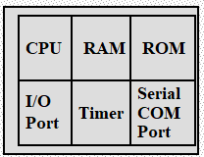
8051 basic components
Harvard Architecture (separate code (ROM) and data (RAM) memory)
4 kilobytes of internal ROM
128 bytes of internal RAM
Four 8-bit I/O ports
Two 16-bit timers or counters
one serial interface
A Single chip Microcontroller

Slide 19
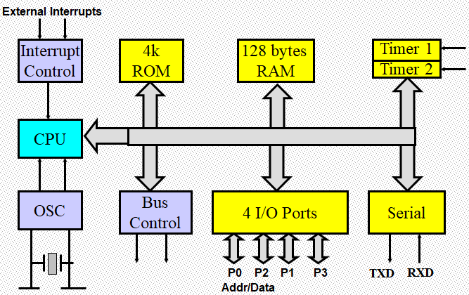
Block Diagram Of 8051 Microcontroller

Slide 20
Features of 8051 microcontroller
8-bit ALU, Accumulator and 8-bit Registers; hence it is an 8-bit microcontroller
8-bit data bus - It can access 8 bits of data in one operation
16-bit address bus - It can access 216 memory locations - 64 KB (65536 locations) each of RAM and ROM
On-chip RAM - 128 bytes (data memory)
On-chip ROM - 4 Kbyte (program memory)
Four byte bi-directional input/output port
UART (serial port)
Two 16-bit Counter/timers: T0 and T1.
Two-level interrupt priority: 2 external & 3 internal interrupt sources.
Oscillator and clock circuits.
Operating frequency: 11.04962 MHz (can vary up to 16MHz in some versions of 8051)

Slide 21
Address Bus (RAM)
128B = 2⁷ →7 bit address for RAM
8 bit: 00h – FFh
00h – 7Fh → internal RAM
80h – FFh →SFR

Slide 22
Address Bus (ROM)
4KB = 4 x 1 KB = 4 x 1024 = 2² x 2¹⁰
= 2¹²
12 bit address for 4KB ROM
16 bit: 0000h – FFFFh
0000h – 0FFFh → internal ROM
1000h – FFFFh →External Memory

Slide 23
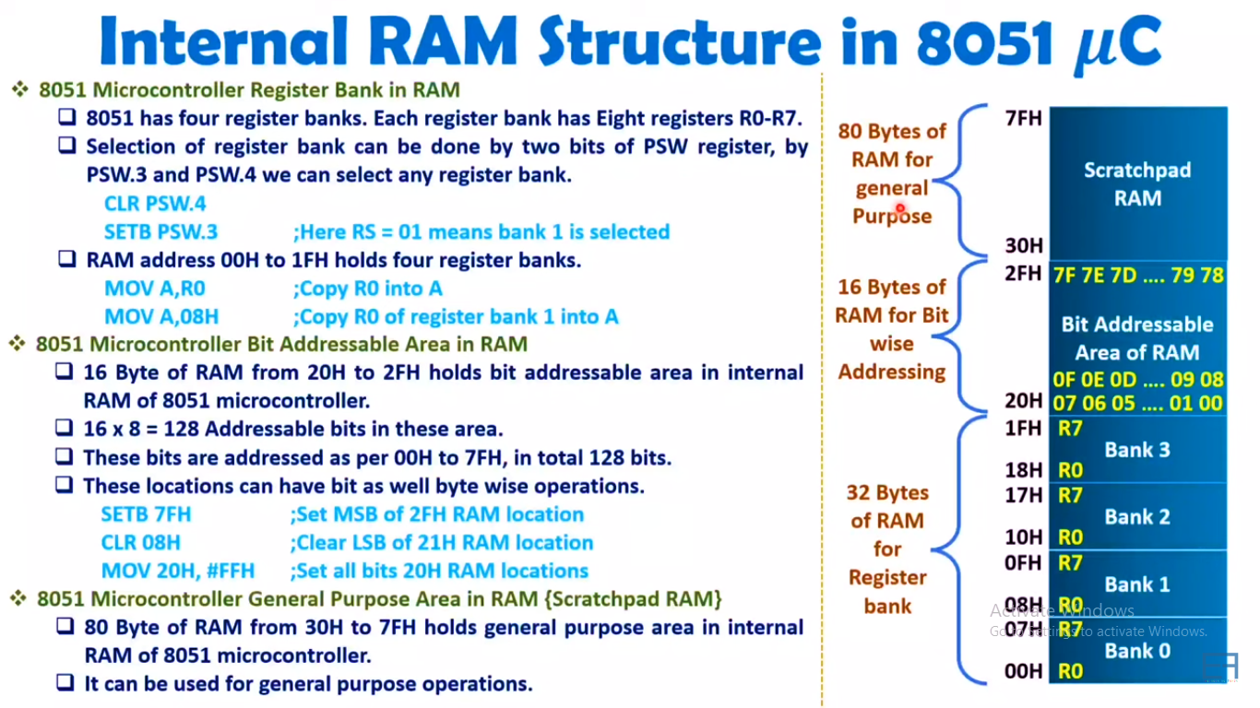

Slide 24
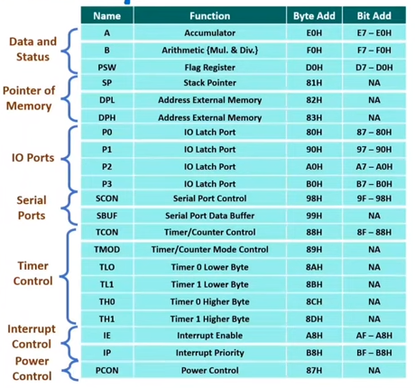
Special Function Registers (SFR)of 8051

Slide 25
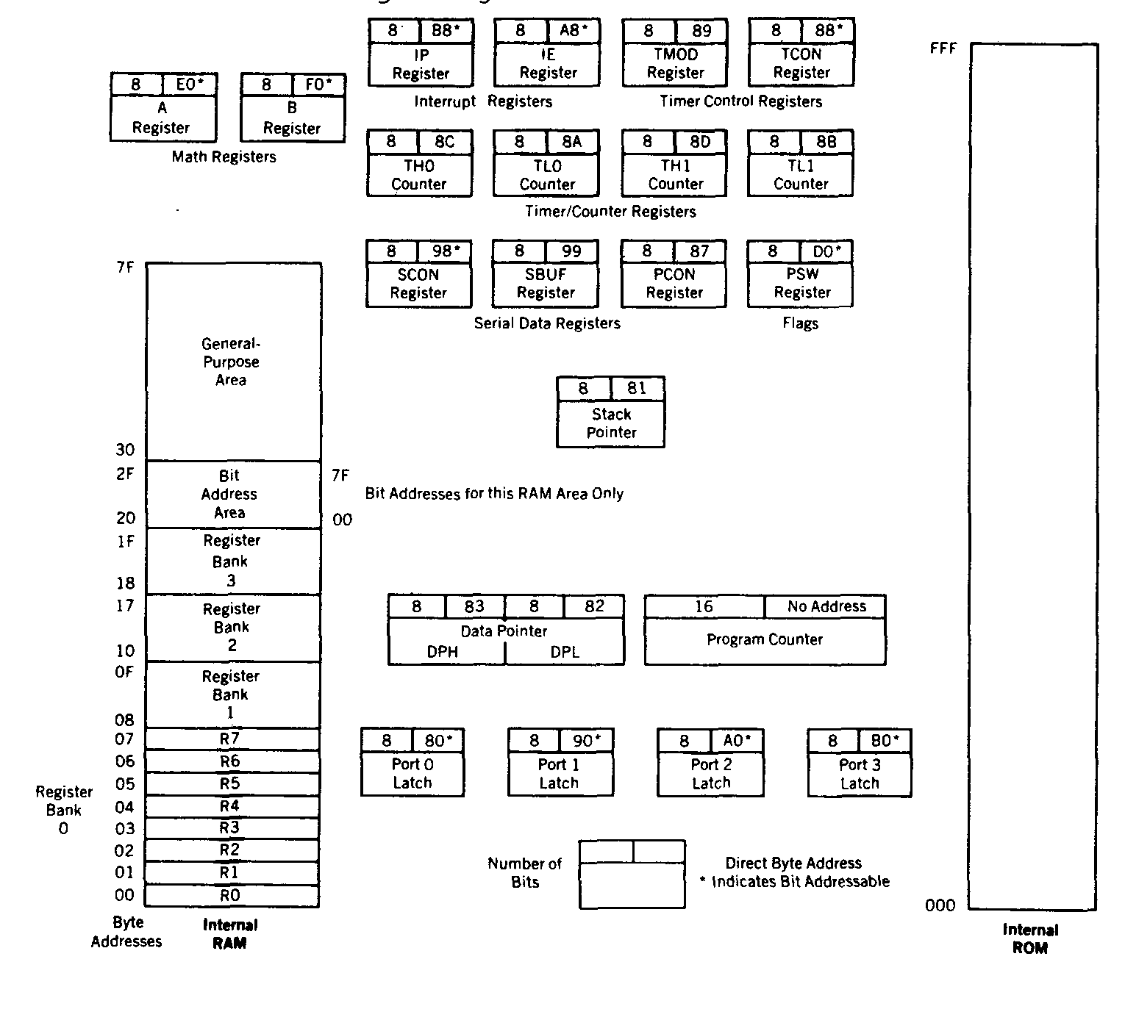
Internal RAM

Slide 26
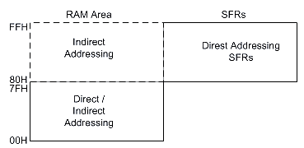
Internal Data Memory and Special Function Register (SFR) Map

Slide 27
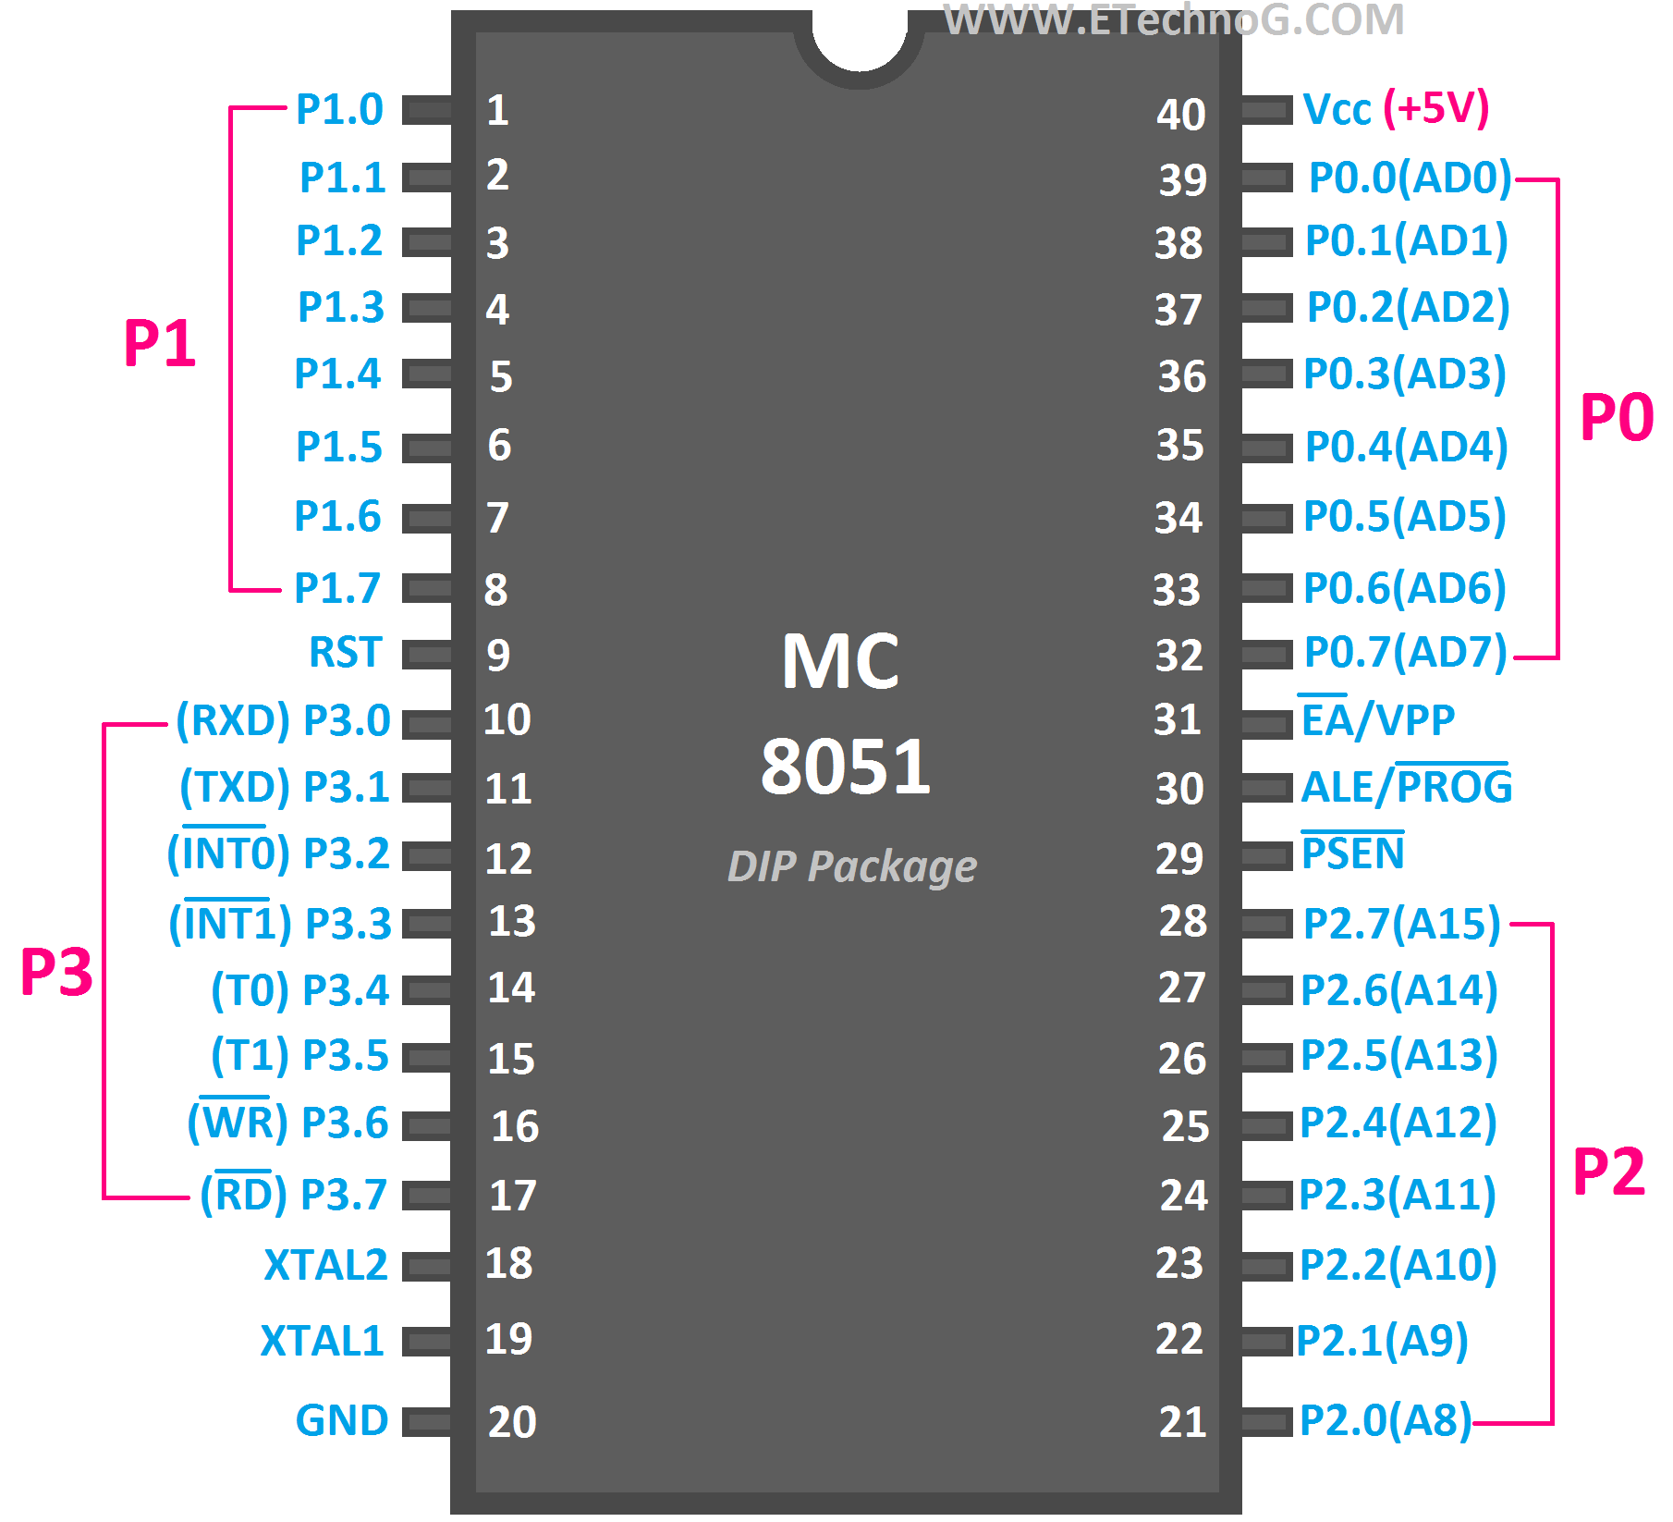
Pin diagram of 8051 Microcontroller

Slide 28
What is port ?
“Port” refers to a group of pins on a microcontroller which can be accessed simultaneously. (8051µC has 4-ports of 8-bits each namely P0-P3)
Physically, port is assigned with a register/memory location to store the data temporarily while transferring through it.
Ports can be programmed as output or input ports by sending 00H (all 0’s) or FFH (all 1’s) initially. By default all ports acts are input ports.
Due to functionality, some pins have two fold roles.
All port pins can be designated as input or output, according to the needs of a device that's being connected to it.

Slide 29
Pin Description of 8051 microcontroller
P0.0- P0.7(AD0-AD7) :
No external memory
The port 0 pins multiplexed with lower order address/data pins if the microcontroller is accessing external memory otherwise acts as general purpose i/o ports.
Performs dual functions

Slide 30
Pin Description of 8051 microcontroller
P1.0- P1.7 :
These 8-pins are dedicated for Port1 to perform input or output port operations.
Doesn’t perform dual functions.

Slide 31
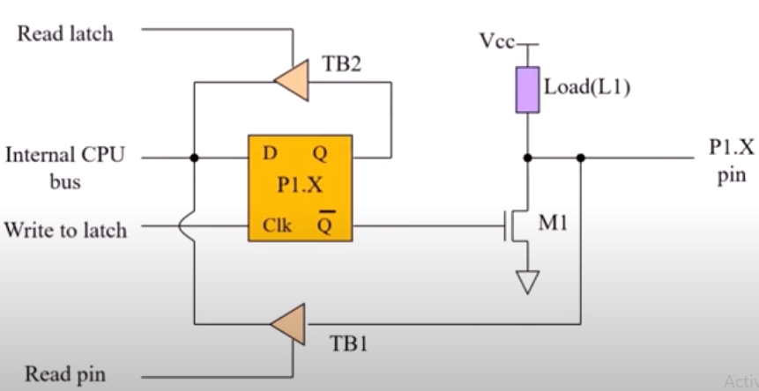
Port-1 Internal structure

Slide 32
Pin Description of 8051 microcontroller
P2.0- P2.7(A8-A15) :
The port2 pins are multiplexed with the higher order address pins when the microcontroller is accessing external memory otherwise they act as i/o pins.

Slide 33
Pin Description of 8051 microcontroller
P3.0- P3.7 :
These 8-pins are meant for i/o operations and also for some control operations like Read, Write, Timer0, Timer1, INT0, INT1, RxD and TxD

Slide 34
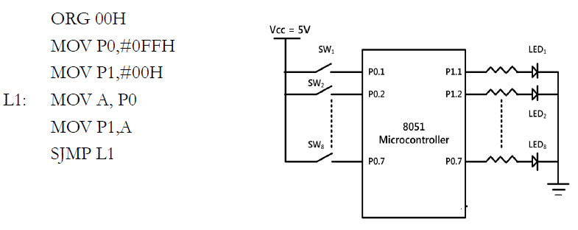
Port programming

Slide 35
Data transfer through ports: Example 2 (Bit addressing)
Write an 8051 ALP to complement P1.2 continually with some delay.
BACK: CPL P1.2 ;complement P1.2
ACALL DELAY ;calling delay program (routine) to create time delay between each complement.
CPL P1.2
ACALL DELAY
SJMP BACK
---time delay program-------the following code is to create delay between every complement (toggle) of P1.2 bit. A delay is required to notice the change (complement). A random amount of delay will be created by decrementing the randomly loaded R3 value to zero.
DELAY: MOV R3,#200 ; 200 is a decimal number. Its hexa decimal equivalent will be saved in R3.
HERE: DJNZ R3,HERE
RET
; Decrement R3 (Any bank register R0-R7 can be used here) and remain here till it becomes ZERO.
; Return to main program where it left while calling (absolute call i.e. ACALL) delay routine.

Slide 36
Pin Description of 8051 microcontroller
RXD:
10th pin is RXD (serial data receive pin) which is for serial input.
Through this input signal microcontroller receives data for serial communication.
TXD:
11th pin is TXD (serial data transmit pin) which is serial output pin.
Through this output signal microcontroller transmits data for serial communication.

Slide 37
Pin Description of 8051 microcontroller
INT0′ and INT1′ :
12th and 13th pins are for External Hardware Interrupt-0 (INT0) and Interrupt-1 (INT1) respectively.
When this interrupt is activated, 8051 gets interrupted from hardware connected to these pins.
When interrupt comes, 8051 serves the interrupt based on their priority. (INT0 is with highest priority)
To serve the interrupt, the processor needs to run a program called interrupt service routine (ISR) which is stored in fixed memory locations (in memory) for particular interrupt.
The interrupt vector address value of the INT0 and INT1 are 0003H and 0013H respectively.

Slide 38
Pin Description of 8051 microcontroller
T0 and T1:
14th and 15th pin are for Timer 0 and Timer 1 external input.
They can be connected with 16 bit timer/counter.
WR’:
16th pin is for external memory write i.e. it write data to the external memory.
RD’:
17th pin is for external memory read i.e. it read data from external memory.

Slide 39
Pin Description of 8051 microcontroller
XTAL2 and XTAL1:
18th and 19th pin these pins are connected to an external oscillator which is generally a quartz crystal oscillator. Frequency of operation is 11.0592 MHz. (it may vary up to 16MHz in some versions of 8051)

Slide 40
Pin Description of 8051 microcontroller
VCC:
This pin provides power supply voltage i.e. +5 Volts to the circuit.
GND:
This pin is connected to the ground.
It has to be provided with 0V power supply.
Hence it is connected to the negative terminal of the power supply.

Slide 41
Pin Description of 8051 microcontroller
RST:
The RESET pin is an input pin and it is an active high pin.
When a high pulse is applied to this pin the microcontroller will reset and terminate all activities.
Upon reset all the registers except stack pointer (SP) register will reset to 0000H Value and SP register will reset to
07H value.

Slide 42
Pin Description of 8051 microcontroller
EA'/VPP :
This pin is connected to ground when microcontroller is accessing the program code stored in the external memory and connected to Vcc (+5V) when it is accessing the program code in the on chip memory.

Slide 43
Pin Description of 8051 microcontroller
PSEN’ :
This is an output pin which is active low.
It will be activated (zero) when the microcontroller is accessing the program code stored in the external ROM. This pin is connected to the OE (Output Enable) pin of the external ROM.

Slide 44
Pin Description of 8051 microcontroller
ALE /PROG:
This is an output pin, which is active high.
When 8051 is connected to external memory, ALE becomes high to de-multiplex the memory address which is available on port 0. (Port 0 provides both address and data on time sharing basis i.e address and data are multiplexed port 0 .
This ALE pin will demultiplex the address and data bus .
During flash programming i.e. Programming of EPROM, this pin acts as program pulse input (PROG).

Slide 45
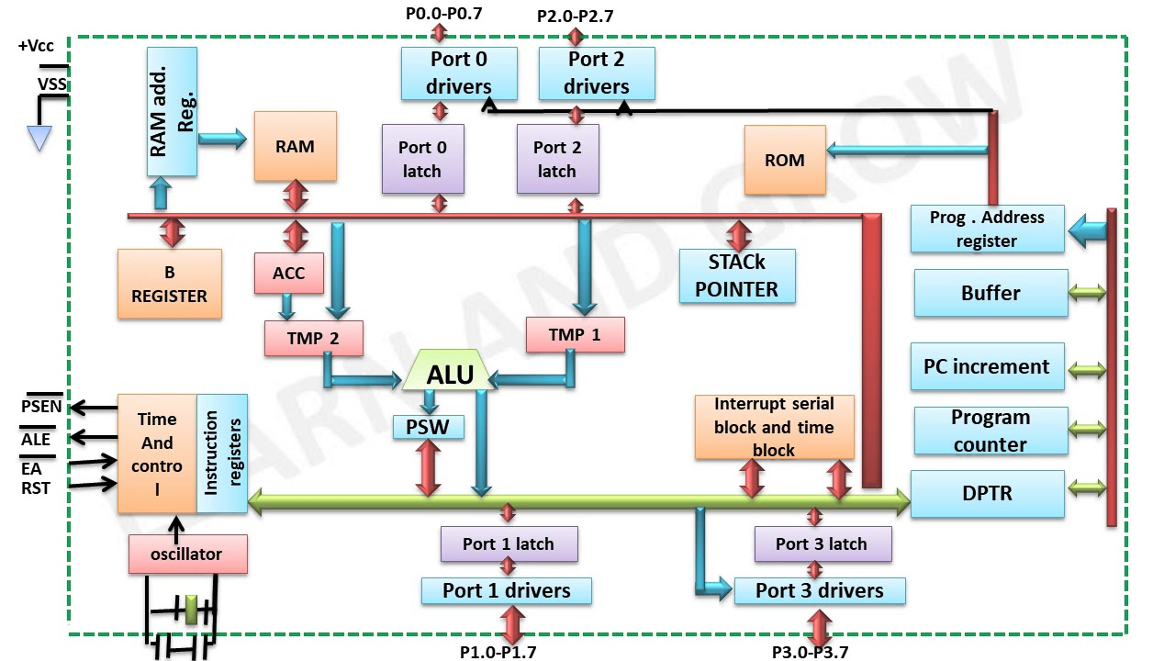
Architecture of 8051 microcontroller

Slide 46
RAM address register and Program address register:
- RAM address register is an 8-bit register.
- Program address register is an 16-bit register.
RAM address register is used to carry the address of the internal RAM (size of 128 Bytes- address range from 00H – 7FH) location which is currently under access.
Program address register is used to carry the address of the internal ROM (size of 4 kB Bytes- address range from 000H – FFFH) location which is currently under access.
Program counter (PC) and Data pointer (DPTR):
- Both are 16-bit registers.
Why 16 bit registers ? - The 8051 can be connected with a maximum of 64 kB of external memory (including RAM and ROM). That is why 16-bit address bus also provided (A0 – A15).
The DPTR can be used as a single 16-bit register or two 8-bit registers (as DPL and DPH).
DPTR doesn’t have a physical Memory Address but the DPL (Lower Byte of DPTR) and DPH (Higher Byte of DPTR) have separate addresses in the special function registers (SFR) Memory Space. DPL = 82H and DPH = 83H.

Slide 47
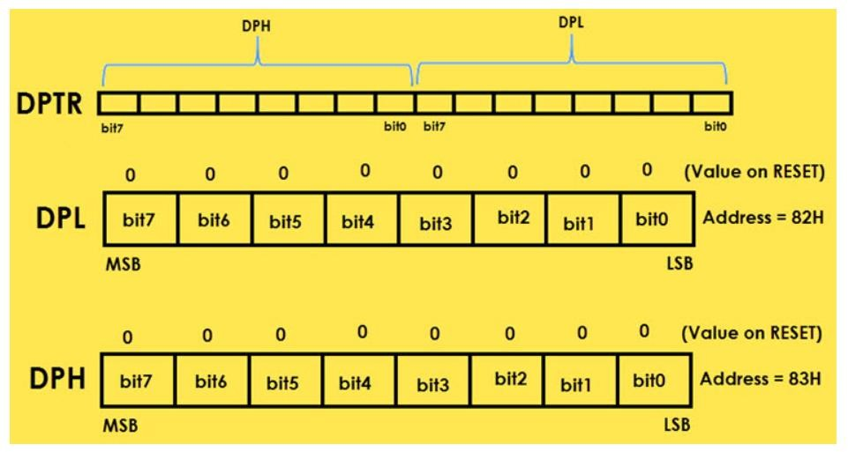
Data pointer (DPTR)

Slide 48
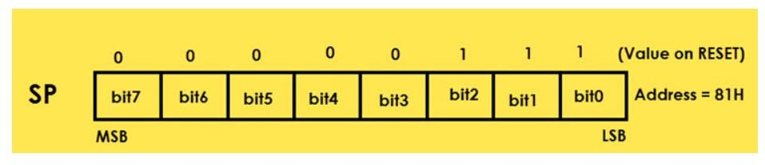
Stack Pointer (SP)
SP or Stack Pointer points out to the top of the Stack and it indicates the next data to be accessed. Stack Pointer can be accessed using PUSH, POP, CALL and RET Instructions. The Stack Pointer is an 8-bit register and upon reset, the Stack Pointer is initialized with 07H.
When writing a new data byte into the stack, the SP (Stack Pointer) is automatically incremented by 1 and the new data is written at an address SP+1. When reading data from stack, the data is retrieved from the Address in SP and after that the SP is decremented by 1 (SP-1).

Slide 49
Stack operation in 8051
STACK:
It is a part of RAM in which data will store temporarily during execution of program.
STACK work on last in first out principle.
To store and retrieve data during program execution in stack, push and pop instructions are used.
PUSH:
its used to store data into stack.
POP:
to retrieve data from stack.
SP:
Stack pointer is 8 bit register which store the address of the stack location up to which it is filled (top of the stack).
By default stack pointer contain 07h. This means Bank 1 of the internal RAM acts as default stack area. The stack area can be relocated to general purpose RAM area by changing the address present in the SP to appropriate value which comes under the address range of general purpose area.

Slide 50
Stack operation in 8051
PUSH: --- SP value will be pre incremented automatically.
In PUSH operation, stack pointer (SP) will be incremented first and then content of register or memory will store on that stack location which shown in SP.
The stack memory location which is available for access is called top of the stack, whose address is shown by SP register.
Examples:
PUSH 0H; SP will be incremented by one and then the content of R0 (memory address 00H) register store into 08H location.
As the default SP value is 07H, it will become 08H after incrementing first time.
PUSH 1H; SP will be incremented by one and then the content of R1 (memory address 01H) register store into 09H location.
PUSH 31H; SP will be incremented again by one and the content of memory location with address 31H stored into 0AH location.

Slide 51
Stack operation in 8051
POP: --- SP value will be post decremented automatically.
In POP operation, data will be retrieved first and then stack pointer decreased by one.
Examples: POP 20H: The content of the top of the stack will be copied into memory location with address 20h, then stack pointer (SP) will be decreased by 1.
Note: For the PUSH and POP instructions, we must specify the direct address of the register/memory location being pushed or popped.

Slide 52
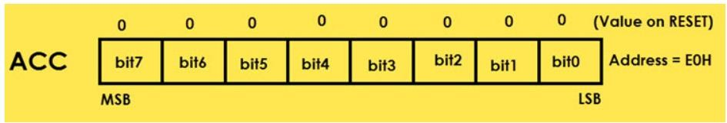
A or Accumulator (ACC)
The Accumulator or Register A is the most important and most used 8051 Microcontroller Special Function Register (SFR). The Register A is located at the address E0H in the SFR memory space. The Accumulator is used to hold the data for almost all the ALU Operations.
Some of the operations where the Accumulator is used are:
Arithmetic Operations like Addition, Subtraction, Multiplication etc.
Logical Operations like AND, OR, NOT etc.
Data Transfer Operations (between 8051 and External Memory)
The name “Accumulator” came from the fact that, this register is used to accumulate (or store) the result of all Arithmetic and most of the Logical Operations.

Slide 53
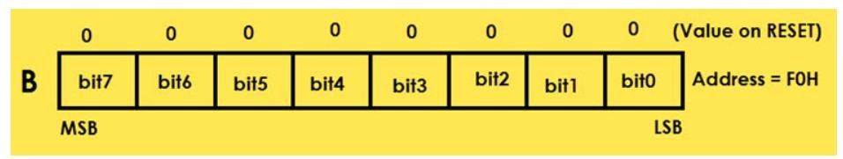
B (Register B)
The B Register is used along with the ACC in Multiplication and Division operations. These two operations are performed on data that are stored only in Registers A and B. During Multiplication Operation, one of the operand (multiplier or multiplicand) is stores in B Register and also the higher byte of the result.
In case of Division Operation, the B Register holds the divisor and also the remainder of the result. It can also be used as a General Purpose Register for normal operations and is often used as an Auxiliary Register by Programmers to store temporary results.
Register B is located at the address F0H of the SFR Address Space.

Slide 54
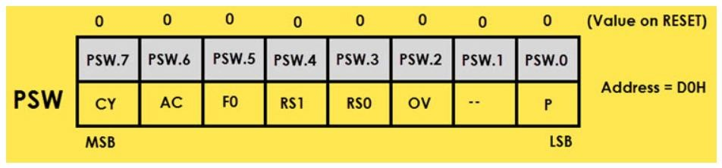
Program Status Word (PSW) : (Also called flag register)
The PSW or Program Status Word Register is also called as Flag Register and is one of the important SFRs. The PSW Register consists of Flag Bits, which help the programmer in checking the condition of the result and also make decisions.
Flags are 1-bit storage elements that store and indicate the nature of the result that is generated by execution of certain instructions. The following image shows the contents of the PSW Register.

Slide 55
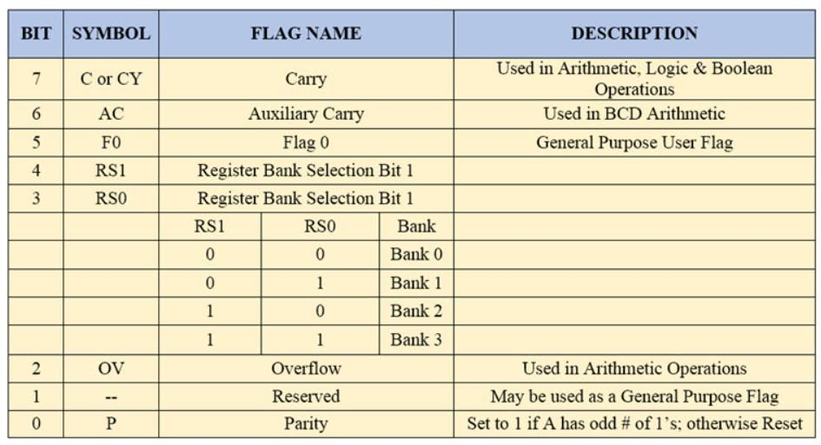
The following table describes the function of each flag.

Slide 56
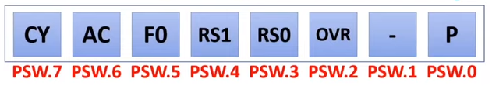
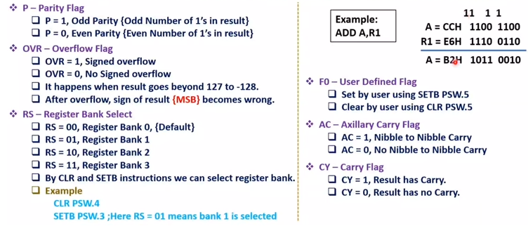
Program Status Word (PSW): Address=D0H

Slide 57
CY:
This is known as carry flag. This says whether there is a carry out of MSB or not.
E.g: 1000 1101 & 1011 1001, Let’s add both bytes
= 0011 0110 There is a carry out of MSB. Therefore in this case CY=1.
AC:
This flag stands for an auxiliary carry. It is given as 1 whenever there is a carry from LN to HN. LN and HN stands for lower nibble and higher nibble. As byte stands for 8 bits, similarly nibble stands for 4 bits. Lower nibble is 0-3 bits and higher nibble is 4-7 bits.
If seen in the above example there was a carry from 3rd bit to 4th bit. So in the above case AC=1.
PARITY:
If there are even number of 1s in the result then the parity will be zero, and if there are odd number of 1s then , parity=1
Eg= 1010 1101 , here there are 5 ones, therefore parity =1
Reserved:
This is a don’t care flag. It has nothing to do with.

Slide 58
OV:
This is an overflow flag. There are two types numbers
The operations for signed and unsigned numbers are the same, but signed numbers overflow between bit 6 and 7, while unsigned numbers overflow between bit 7 and 8.
The OV flag represents the overflow into bit 7, while the CY flag represents the overflow into bit 8. So, for a signed operation, you'd check the OV flag, while for an unsigned operation you'd check the CY flag after the operation.
Signed
Unsigned
Unsigned:
This is a 8 bit positive number which ranges from 0 to 255. In hexadecimal it’s range is from 00 to FF. In the OV flag, it has nothing to do with unsigned numbers. Only signed numbers are considered in the OV flag.
Signed:
This is also a 8-bit number which is equally distributed among +ve and -ve numbers. By considering MSB , it is decided whether it is a positive or negative number. If MSB=1 , it is a negative number or else a positive number.
Eg: 1011 0011 is -ve
0111 1001 is +ve
So it’s positive range is from 0 to 127 [ 00 to 7F (in hexadecimal ) ], it consists of 128 +ve values. It also has 128 negative numbers ranging from -1 to -128 [ -01 to -80 ( in hexadecimal ) ].
55
https://electronics.stackexchange.com/

Slide 59
F0 :
This is a user defined bit flag, where users can store any data.
RS₁ and RS₀ :
Internal RAM of 8051 is 128 bytes out of which 32 bytes are stored in registers ( 8085, 8086 has 7,8 registers only ). These all 32 registers are divided into 4 banks, each bank has 8 registers starting from R₀ to R₇.
Let’s assume there is an operation that should be performed on R₁, then how it decides from which bank the register is selected?
This is performed based on banks
By setting the values of RS₁ and RS₀ , we can select the register.
This instruction stands for RS₁ = 1 , and RS₀ = 0, which means bank 2.

Slide 60
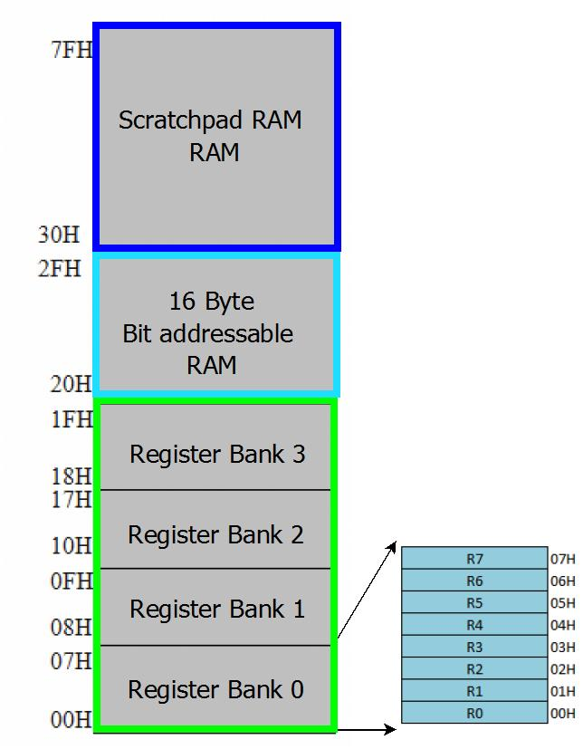
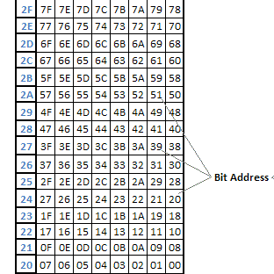
Internal memory - Internal RAM (Data memory)
Stack (default)

Slide 61
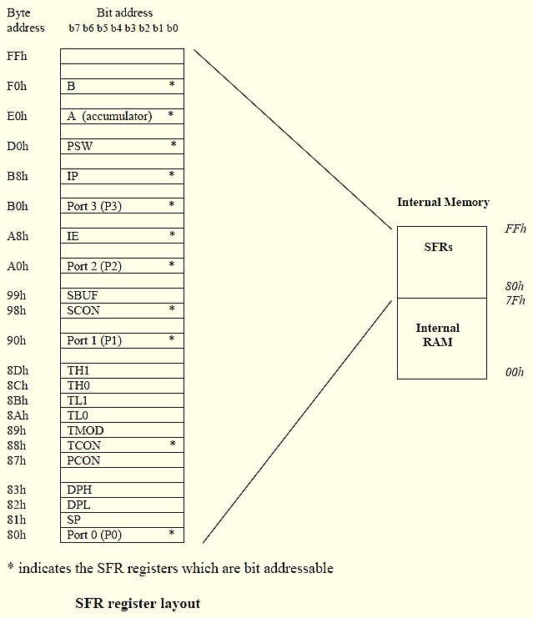
Internal Memory - SFR (Special function registers) memory Note: SFR memory is a separate memory space available on-chip (internally). It wont come under internal ROM (code memory) or Internal RAM (data memory).
Here, * indicates the
bit-addressable SFRs

Slide 62
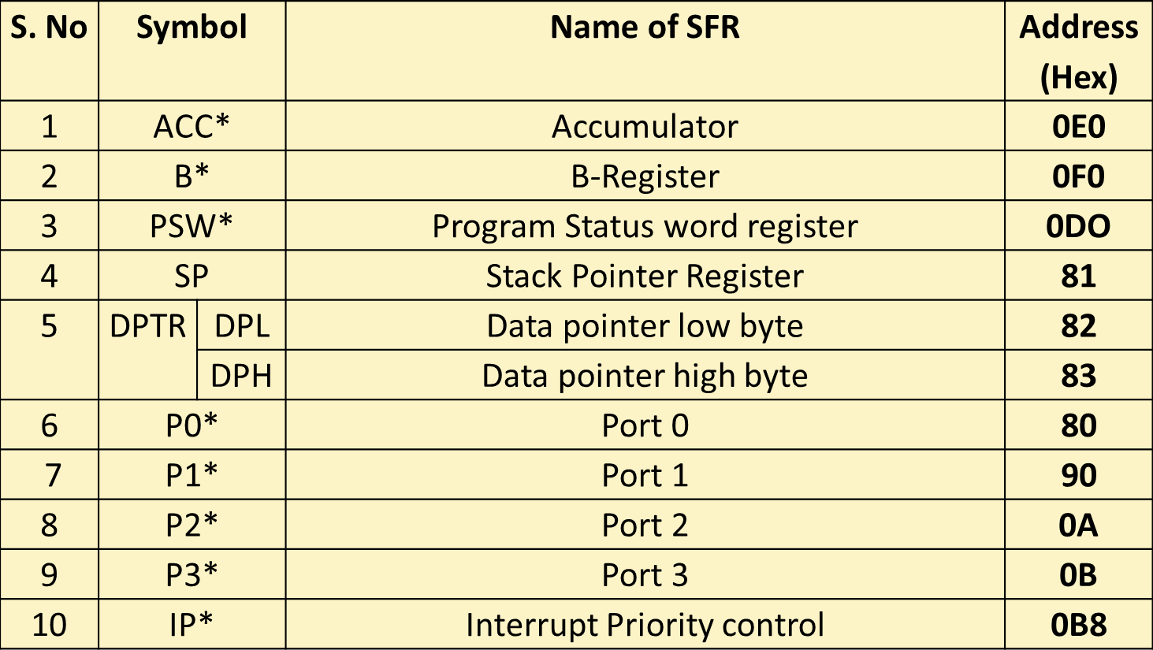
Special Function Registers (SFR)
Here, * indicates the
bit-addressable SFRs

Slide 63
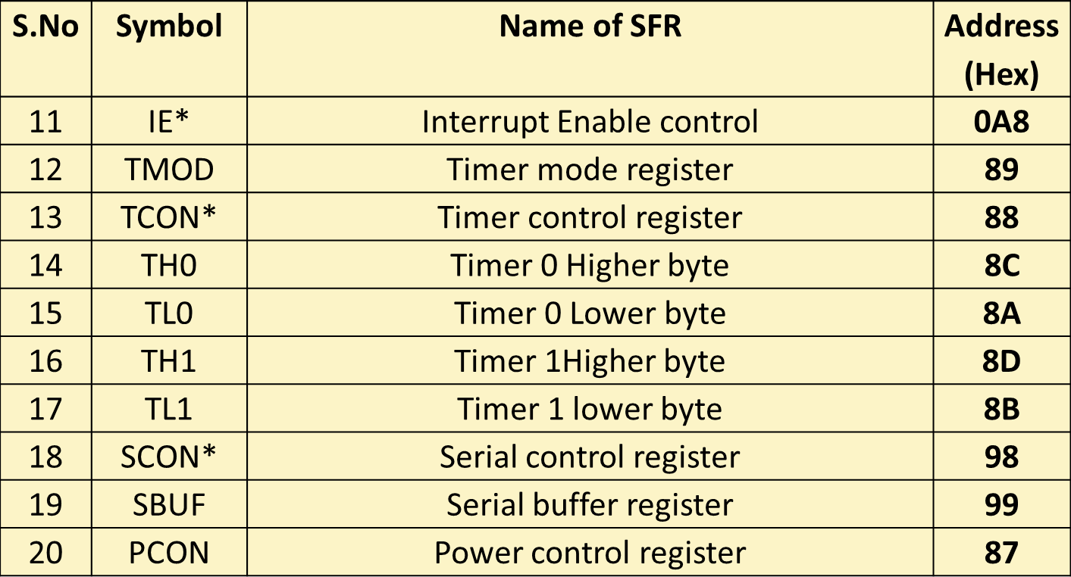
Special Function Registers (SFR)
Here, * indicates the bit-addressable SFRs
76

Slide 64
Widely used Register set of 8051
SP
DPH
DPL
PSW
DPTR
A
B
PC
R0
R1
R2
R3
R4
R5
R6
R7
8-bit Registers of 8051
16-bit Registers of 8051

Slide 65
Instruction set of 8051
DATA TRANSFER | ARITHMETIC | LOGICAL
MOV – Move with internal RAM (data memory) | ADD | ANL – Logical AND
MOVC – Move with Code memory (ROM) | ADDC – Add with Carry | ORL – Logical OR
MOVX – Move with external memory | SUBB – Subtract with Borrow | XRL – Logical XOR
PUSH – push data in to stack | INC - Increment | CLR - Clear
POP– pop data from stack | DEC - Decrement | CPL - Complement
XCH – Exchange the contents of two operands | MUL – Multiplication (Only A and B registers are allowed as operands with MUL and DIV instructions) | RL – Rotate left the content of the operand.
Only direct addressing is allowed in PUSH and POP | DIV – Division Examples: MUL AB, DIV AB. No comma required between A and B | RLC – Rotate left the content of the operand along with carry flag.
 | DAA – Decimal Adjust Accumulator. (used in BCD arithmetic) | RR– Rotate right the content of the operand.
 |  | RRC– Rotate right the content of the operand along with carry flag.
 |  | RLA– Rotate left the content of the Accumulator.
 |  | SWAP – Swap the lower and higher nibbles of the operand.

Slide 66
Instruction set of 8051
BOOLEAN | PROGRAM BRANCHING
SETB -Set Bit | JMP – Jump (Unconditional)
JC -Jump if Carry | AJMP – Absolute Jump (jump range 2kB.)
JNC – Jump if no carry | SJMP - Short Jump (jump range 128 Bytes.)
JB – Jump if Bit set to 1 | JZ – Jump if A=0
JNB- Jump if no Bit | JNZ – Jump if A≠0
JBC – Jump if bit and clear the bit after jump | CJNE – Compare and jump if not equal. (Compare the contents of the operands)
 | DJNZ – Decrement the operand once and jump if it is not zero
 | NOP – No operation
 | RET – Return to main program from subprogram (Example: Delay routine.)
 | ACALL– Absolute Call (Range: 2kB)
 | LCALL - Long Call (range: 64kB)

Slide 67
8051 Addressing modes
An assembly language program (ALP) is a collection of instructions which need to be executed in sequential order. An example ALP is given as, MOV A,31H
Opcode Operand
Opcode defines the type of operation; Operand specifies the source and destinations on which operand is going to work.
Addressing mode defines the style (method) of writing an assembly language instruction while programming a particular processor. Addressing modes are processor dependent.

Slide 68
8051 Addressing modes
Immediate addressing mode
MOV A, #6AH
Operand contains data on which operation is going to perform.
2) Direct addressing mode
MOV A, 04H
Operand contains address of the memory location where data is stored (on which operation is going to perform).

Slide 69
8051 Addressing modes
3) Register direct addressing mode (Register addressing mode)
MOV A, R4
(Registers can be R0,R1…to R7 from register selected bank of internal RAM. Direct data transfer between any two bank registers is not allowed. Can be done through Accumulator (A)).
Example:
MOV R1,R3 (This is not allowed.)
This can be done through accumulator as follows.
MOV A,R3
MOV R1,A

Slide 70
8051 Addressing modes
4) Register indirect addressing mode
MOV A, @R0
Note: Only R0 and R1 are allowed to form a register indirect addressing instruction.
5) Indexed addressing mode
MOVC A, @A+DPTR
6) Relative Addressing : SJMP LABEL_X (range of + 127 to –128 locations)
7) Absolute addressing : Absolute addressing within the 8051 is used only by the AJMP (Absolute Jump) and ACALL (Absolute Call) Instructions. Allows a jump with a 2KByte address boundary (a 2K page)

Slide 71
8051 Addressing modes
8) Implied/Implicit Addressing Mode
In the implied addressing mode, there will be a single operand. These types of instruction can work on specific registers only.
These types of instructions are also known as register specific instructions.
Examples:
RLA (Rotate left accumulator content by one time)
SWAPA (Swap the lower and higher nibbles (4-bits) of accumulator)

Slide 72
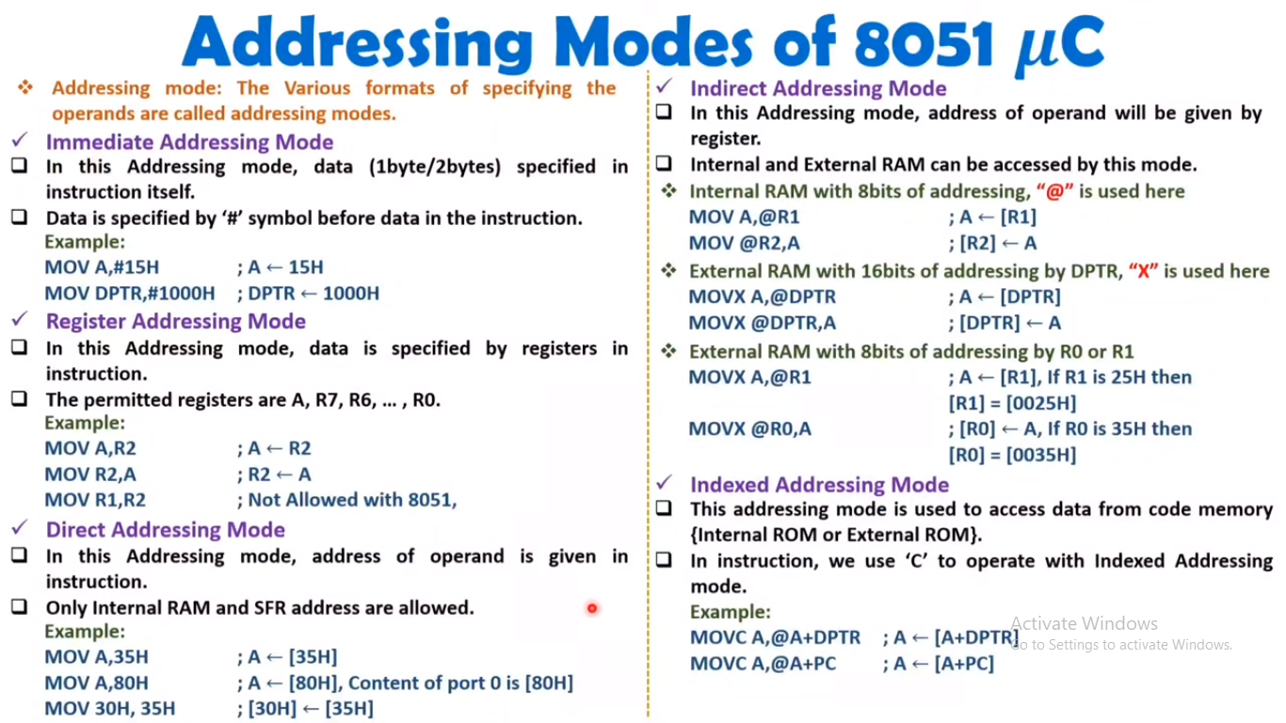

Slide 73
8051 ALP example 1 (addressing modes)
Write an ALP to copy the value 55H into RAM memory locations 40H to 41H using
(a) direct addressing mode, (b) register indirect addressing mode without a loop, and (c) with a loop
(c) ORG 0H
MOV A,#55H
MOV R0,#40H
MOV R2,#02
AGAIN: MOV @R0,A
INC R0
DJNZ R2,AGAIN
END
(a) ORG 0H ;start storing at 0H location onwards.
MOV A,#55H ;load A with value 55H
MOV 40H,A ;copy A to RAM location 40H
MOV 41H.A ;copy A to RAM location 41H
END ;end of asm source file
(b) ORG 0H ; start storing at 0H location onwards.
MOV A,#55H ;load A with value 55H
MOV R0,#40H ;load the register R0=40H. (R0 is the pointer)
MOV @R0,A ;copy A in to RAM location whose address is pointed by R0.
INC R0 ;increment pointer. Now R0=41h
MOV @R0,A ;copy A to memory address where R0 points to
END ;end of asm source file. (end converting machine code)

Slide 74
Example 5-3
Write a program to copy the value 55H into RAM memory locations 40H to 45H using
(a) direct addressing mode, (b) register indirect addressing mode without a loop, and
(c) with a loop.
Solution:
(a)
MOV A,#55H ;load A with value 55H
MOV 40H,A ;copy A to RAM location 40H
MOV 41H,A ;copy A to RAM location 41H
MOV 42H,A ;copy A to RAM location 42H
MOV 43H,A ;copy A to RAM location 43H
MOV 44H,A ;copy A to RAM location 44H

Slide 75
Example 5-3
Write a program to copy the value 55H into RAM memory locations 40H to 45H using
(a) direct addressing mode, (b) register indirect addressing mode without a loop, and
(c) with a loop.
Solution:
(b) MOV A,#55H ;load A with value 55H
MOV R0,#40H ;load the pointer. R0=40H
MOV @R0,A ;copy A to RAM location R0 points to
INC R0 ;increment pointer. Now R0=41H
MOV @R0,A ;copy A to RAM location R0 points to
INC R0 ;increment pointer. Now R0=42H
MOV @R0,A ;copy A to RAM location R0 points to
INC R0 ;increment pointer. Now R0=43H
MOV @R0,A ;copy A to RAM location R0 points to
INC R0 ;increment pointer. Now R0=44H
MOV @R0,A

Slide 76
Example 5-3
Write a program to copy the value 55H into RAM memory locations 40H to 45H using
(a) direct addressing mode, (b) register indirect addressing mode without a loop, and
(c) with a loop.
Solution:
(c)
MOV A,#55 ;A=55H
MOV R0,#40H ;load pointer. R0=40H, RAM address
MOV R2,#05 ;load counter, R2=5
AGAIN: MOV @R0,A ;copy 55H to RAM location R0 points to
INC R0 ;increment R0 pointer
DJNZ R2,AGAIN ;loop until counter = zero

Slide 77
Example 5-4
Write a program to clear 16 RAM locations starting at RAM address 60H.
Solution:
CLR A ;A=0
MOV R1,#60H ;load pointer. R1=60H
MOV R7,#16 ;load counter, R7=16 (10 in hex)
AGAIN: MOV @R1,A ;clear RAM location R1 points to
INC R1 ;increment R1 pointer
DJNZ R7,AGAIN ;loop until counter = zero

Slide 78
Example 5-5
Write a program to copy a block of 10 bytes of data from RAM locations starting at 35H to RAM locations starting at 60H.
Solution:
MOV R0,#35H ;source pointer
MOV R1,#60H ;destination pointer
MOV R3,#10 ;counter
BACK: MOV A,@R0 ;get a byte from source
MOV @R1,A ;copy it to destination
INC R0 ;increment source pointer
INC R1 ;increment destination pointer
DJNZ R3,BACK ;keep doing it for all ten bytes

Slide 79
8051 ALP example 2 (stack operation)
Move the data between registers and stack; Examine the stack, contents of the registers ,SP.
(All values are in hexa decimal.)
Note: For the PUSH and POP instructions, we must specify the direct address of the register/memory location being pushed or popped.
ORG 0H
MOV R6,#25H
MOV R1,#12H
MOV R4,#0F3H
PUSH 6H
PUSH 1H
PUSH 4H
POP 33H
HERE: SJMP HERE
END
(Note: if a hexa decimal number is starting with an alphabet, a ZERO (0) should be appended in front of it)
In this question, it is not asked to relocate the stack and not asked to select the register bank. So, by default, BANK-1 will act as stack (range from 08H-0FH). BANK-0 acts as default register bank. So, the registers (R0-R7) used in this program will be considered from BANK-0.
In this program, the contents of R6 (06H), R1 (01H), R4 (04H) are pushed in to stack locations 08H, 09H, and 0AH respectively. After this, top of the stack will be 0AH (can be seen as SP=09H). Then the contents of the top of the stack (i.e. contents of the 0AH location) will be poped in to memory location whose address is 33H. After POP operation, the SP value will be decremented to 09H. (Which will now act as top of the stack.)

Slide 80
8051 ALP example 3 (stack operation)
Example for data swapping (reversing)
Write an ALP to load given values into each of registers R0 - R4, then push each of these register contents in to the stack and pop them back. Examine the stack and the SP register after the execution of each instruction.
ORG 0000H
MOV R0, #25H
MOV R1, #35H
MOV R2, #45H
MOV R3, #55H
MOV R4, #65H
PUSH 0
PUSH 1
PUSH 2
PUSH 3
PUSH 4
POP 0H
POP 1H
POP 2H
POP 3H
POP 4H
END
In this program, default stack location i.e. BANK-1 will be available.
For default stack, SP=07H (initially).
All the registers such as R0-R7 used in this program are selected from default bank i.e. BANK-0.
BANK-0 address range is from 00H to 07H named as R0 to R7 respectively, as given below
00H=R0; 01H=R1; 02H=R2; 03H=R3; 04H=R4; 05H=R5; 06H=R6; 07H=R7;

Slide 81
8051 ALP example 4 (stack operation)
Write an 8051 assemble language program (ALP) by considering following conditions while writing the program.
(a) Relocate the stack to general purpose (scratch pad) RAM area; (b) select BANK-3 registers by writing appropriate value in to PSW; (c) Load the R0 to R4 registers of the selected bank with data 0DH, F2H, 0BH, 05H, and 08H, respectively. (d) PUSH the contents of the registers R0-R4 in to stack. (e) POP the contents of the stack in to R3 to R7 registers. (Observe the SP value after every PUSH and POP operation.)
ORG 0000H
MOV SP, #36H ; The SP is loaded with 36H to relocate the stack with in the range of scratch pad RAM area (30H to FFH).
MOV PSW, #18H ; RS1 and RS0 bits of PSW are set to ‘1’ to select BANK-3 (R0-R7 of BANK-3 will be selected).
MOV R0, #0DH
MOV R1, #0F2H
MOV R2, #0BH
MOV R3, #05H
MOV R4 #08H
PUSH 18H
PUSH 19H
PUSH 1AH
PUSH 1BH
PUSH 1CH
POP 1BH
See PSW format for more details. It will be 00011000=18H
POP 1CH
POP 1DH
POP 1EH
POP 1FH
END
BANK-3 address range is from 18H to 1FH named as R0 to R7 respectively, as given below
18H=R0; 19H=R1; 1AH=R2; 1BH=R3; 1CH=R4; 1DH=R5; 1EH=R6; 1FH=R7;

Slide 82
ORG 0000H
MOV A, #00H
MOV DPTR, #0200H
MOV R1, #0EH ; length of string
MOV R0, #40H ; starting RAM address
LOOP: CLR A
MOVC A,@A+DPTR
MOV @R0, A
INC DPTR
INC R0
DJNZ R1, LOOP
HERE: SJMP HERE
ORG 0200H
DB "VIT UNIVERSITY"
END
8051 ALP example 5 (Data transfer between ROM and RAM)
Write a program to transfer a string of data "VIT UNIVERSITY" from code memory (ROM) space starting at address 200H to data memory (RAM) locations starting at 40H.
In this program, assembler directive ORG is used twice. Both ORG will be executed in parallel.
One ORG is used to define the starting address location (here 0000H) from which this program need to be stored in ROM. Another ORG defines the starting address location (here 200H) where given string is stored in ROM.
String length i.e number of characters in the given string is 14=0EH
String is a group of characters. ‘Space’ is also a character. All the characters will be translated in to equivalent ASCII codes and stored in the memory.
One character occupies one memory location. Hence, each character in the string is associated with one memory address.
; starting ROM address
; Decrement R1 once and back to loop if R1 is non zero.

Slide 83
Example program6 – Bit addressing
Find out to which by each of the following bits belongs. Give the address of the RAM byte in hex
(a) SETB 42H, (b) CLR 67H, (c) CLR 0FH
(d) SETB 28H, (e) CLR 12, (f) SETB 05

Slide 84
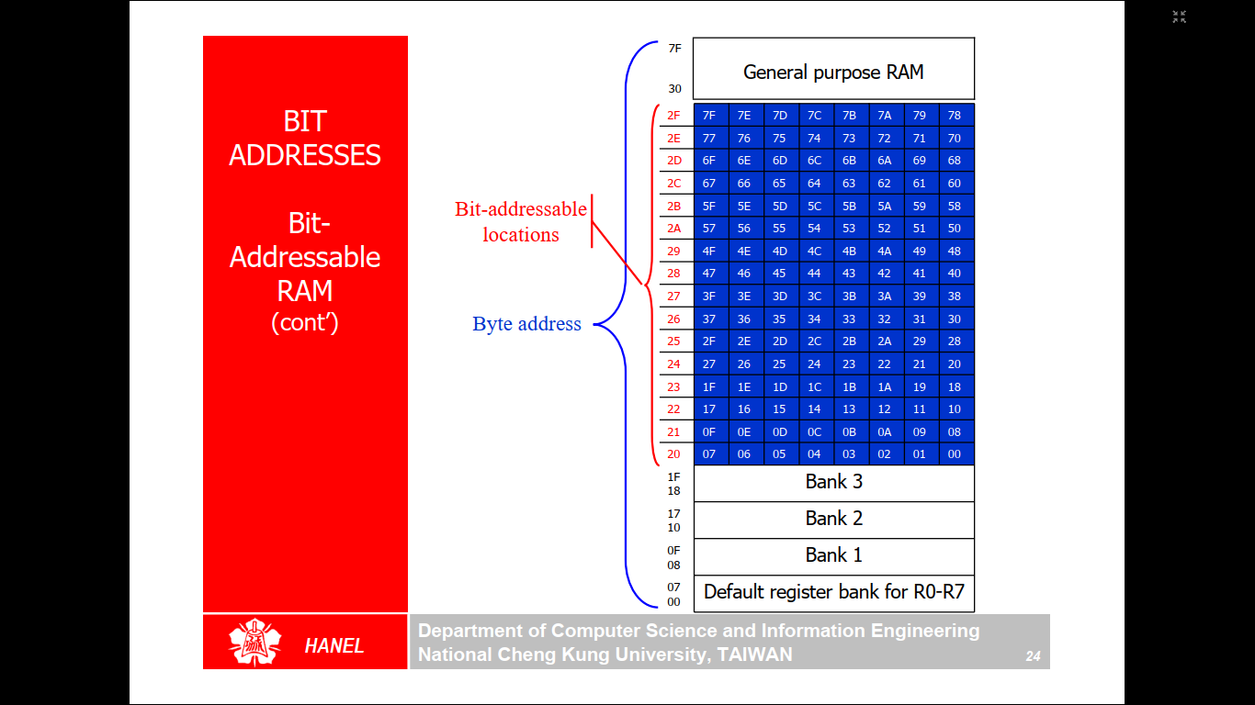
Bit addressing in internal RAM (data memory)
Bit address

Slide 85
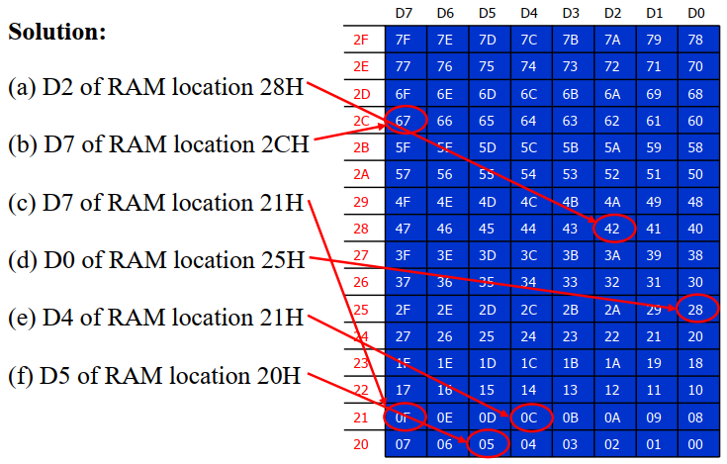
Example program6 – Bit addressing
Find out to which by each of the following bits belongs. Give the address of the RAM byte in hex
(a) SETB 42H, (b) CLR 67H, (c) CLR 0FH
(d) SETB 28H, (e) CLR 12, (f) SETB 05

Slide 86
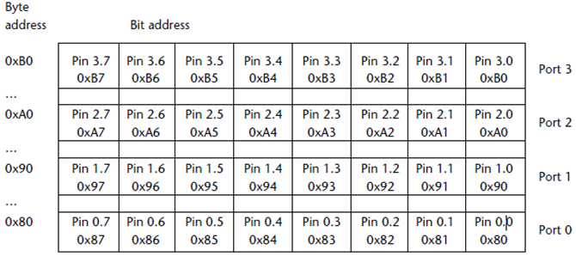
Example program7 – Bit addressing
Assume all RAM locations are cleared before running this program. Simulate the code and find out the result.
ORG 0H
SETB 92H
SETB 93H
MOV C,P1.2
MOV 6,C
MOV C,P1.3
MOV 7,C
END
2nd Bit address of port-1
3rd Bit address of port-1
6H is the Address from Bit addressable area
7H is the Address from Bit addressable area
Bit addressing of ports

Slide 87
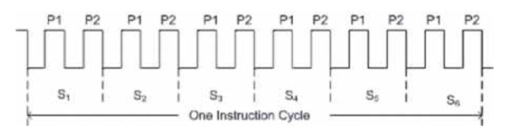
Machine cycle of 8051
Machine cycle is a measure (unit) of calculating the time taken by the 8051 to complete an instruction.
The time taken to complete any instruction is measured in terms of machine cycle or instruction cycle. In 8051 one machine cycle consists 12 clock cycles.
A clock cycle is the time period of the square wave which is generated by the crystal oscillator connected to XTAL pins of 8051.
Which means, machine cycle frequency = 1/12 of the clock frequency
Time period of a 8051 machine cycle for 11.0592 MHz crystal (clock) frequency:
Machine cycle frequency = 11.0592M/12 = 921.6 kHz;
Time period of machine cycle is 1/921.6 kHz = 1.085μs

Slide 88
Time delay calculation with Machine cycle
For 8051 system of 11.0592 MHz, see the below list to find how long 8051 takes to execute each of the following instruction.
(a) MOV R3,#55 (b) DEC R3 (c) DJNZ R2 target (d) LJMP (e) SJMP
(f) NOP (g) MUL AB
Machine cycles Time to execute
(a) 1 1x1.085μs ＝ 1.085μs
(b) 1 1x1.085μs ＝ 1.085μs
(c) 2 2x1.085μs ＝ 2.17μs
(d) 2 2x1.085μs ＝ 2.17μs
(e) 2 2x1.085μs ＝ 2.17μs
(f) 1 1x1.085μs ＝ 1.085μs
(g) 4 4x1.085μs ＝ 4.34μs

Slide 89
Calculation of execution time with Machine cycle
Find the time (delay) taken by 8051 for the execution of following program, if the crystal (clock) frequency is 11.0592MHz.
MOV R3,#250 1
HERE: NOP 1
NOP 1
NOP 1
NOP 1
DJNZ R3,HERE 2
Solution:
The time delay inside HERE loop is
[250(1+1+1+1+2)]x1.085μs ＝ 1627.5μs.
Considering the instruction outside the loop we have
1627.5μs + (1 x 1.085μs) ＝ 1630.755μs
In this program, number of machine cycles consumed by each instruction is listed.
A value of 250 (which is in decimal form) is loaded in to R3.
The hexa decimal equivalent of decimal number 250 will be loaded in to R3.
250 (Decimal) = FA (Hexa)

Slide 90
Time delay calculation with Machine cycle
Find the size of the delay created by delay routine (sub program) in following program, if the crystal frequency is 11.0592MHz.
MOV A,#55H
AGAIN: MOV P1,A
ACALL DELAY ; calling delay program (routine)
CPL A
SJMP AGAIN
---delay program (routine) to generate delay-------An amount of delay will be created by decrementing the loaded R3 value to zero.
DELAY: MOV R3,#200 ; 200 is a decimal number. Its hexa decimal equivalent will be saved in R3.
HERE: DJNZ R3,HERE
RET
Solution: Delay produced by delay routine: [1+(200x2)+2]x1.085μs ＝ 436.255μs.
; Decrement R3 (Any bank register R0-R7 can be used here) and remain here till it becomes ZERO.
; Return to main program where it left while calling (absolute call i.e. ACALL) delay routine.

Slide 91
Module 4:
Microcontroller 8051 Peripherals
I/O Ports, Timers-Counters, Serial Communication and Interrupts.
References:
Muhammed Ali Mazidi, Janice GillispieMazidi ,Rolin D Mc Kinlay ,The 8051 Microcontroller and Embedded Systems Using Assembly and C , Second Edition ,2008 , Pearson Education
The 8051 microcontroller : architecture, programming, and applications, Kenneth J. Ayala
Course Outcomes:
CO4: Deploy the implementation of various peripherals such as general purpose input/
output, timers, serial communication, LCD, keypad and ADC with 8051
microcontroller
2

Slide 92
Instruction set of 8051
DATA TRANSFER | ARITHMETIC | LOGICAL
MOV – Move with internal RAM (data memory) | ADD | ANL – Logical AND
MOVC – Move with Code memory (ROM) | ADDC – Add with Carry | ORL – Logical OR
MOVX – Move with external memory | SUBB – Subtract with Borrow | XRL – Logical XOR
PUSH – push data in to stack | INC - Increment | CLR - Clear
POP– pop data from stack | DEC - Decrement | CPL - Complement
XCH – Exchange the contents of two operands | MUL – Multiplication (Only A and B registers are allowed as operands with MUL and DIV instructions) | RL – Rotate left the content of the operand.
Only direct addressing is allowed in PUSH and POP | DIV – Division Examples: MUL AB, DIV AB. No comma required between A and B | RLC – Rotate left the content of the operand along with carry flag.
 | DAA – Decimal Adjust Accumulator. (used in BCD arithmetic) | RR– Rotate right the content of the operand.
 |  | RRC– Rotate right the content of the operand along with carry flag.
 |  | RLA– Rotate left the content of the Accumulator.
 |  | SWAP – Swap the lower and higher nibbles of the operand.

Slide 93
Instruction set of 8051
BOOLEAN | PROGRAM BRANCHING
SETB -Set Bit | JMP – Jump (Unconditional)
JC -Jump if Carry | AJMP – Absolute Jump (jump range 2kB.)
JNC – Jump if no carry | SJMP - Short Jump (jump range 128 Bytes.)
JB – Jump if Bit set to 1 | JZ – Jump if A=0
JNB- Jump if no Bit | JNZ – Jump if A≠0
JBC – Jump if bit and clear the bit after jump | CJNE – Compare and jump if not equal. (Compare the contents of the operands)
 | DJNZ – Decrement the operand once and jump if it is not zero
 | NOP – No operation
 | RET – Return to main program from subprogram (Example: Delay routine.)
 | ACALL– Absolute Call (Range: 2kB)
 | LCALL - Long Call (range: 64kB)

Slide 94
I/O ports of 8051
4 I/O ports namely PORT-0, PORT-1, PORT-2, PORT-3 are available.
All ports are 8-bit ports. (P0.0-P0.7; P1.0-P1.7; P2.0-P2.7; P3.0-P3.7;)
All ports are bit as well as byte addressable.
For example P1 refers to all 8-bits of PORT-0 i.e P0.0-P0.7 (byte addressing). On the other hand, a single bit let us say P1.2 can also be accessed (bit addressing).
Physically, port is assigned with a register/memory location to store the data temporarily while transferring through it.
Ports can be programmed as output or input ports by sending 00H (all 0’s) or FFH (all 1’s) initially.
By default all ports acts are input ports.
All port pins can be designated as input or output, according to the needs of the device (peripheral) that's being connected to it.

Slide 95
Port programming: Data transfer through ports: Example 1
By default all ports acts are input ports.
Since any port is an input port by default, it is not necessary to write all 1s in to it (before receiving data). But if we want to send data, then we have to make the port as output port by sending all 0’s initially. However, if we want to reprogram that port (which is already an output port) as input port, then we have to send all 1’s before receiving data.
Note: Accumulater (A) is the only register allowed for the data transfer through ports.
MOV A,#00H ;A=00H; hexa decimal (all 0’s)
MOV P1,A ;make P1 an o/p port by writing it all 0s
BACK: MOV A,P0
MOV P1,A ;send it to port 1
SJMP BACK ;keep doing it
;get data from P0. (Assume an input peripheral (hardware)
is connected to port-0)

Slide 96
Data transfer through ports: Example 2 (Bit addressing)
Write an 8051 ALP to complement P1.2 continually with some delay.
BACK: CPL P1.2 ;complement P1.2
ACALL DELAY ;calling delay program (routine) to create time delay between each complement.
CPL P1.2
ACALL DELAY
SJMP BACK
---time delay program-------the following code is to create delay between every complement (toggle) of P1.2 bit. A delay is required to notice the change (complement). A random amount of delay will be created by decrementing the randomly loaded R3 value to zero.
DELAY: MOV R3,#200 ; 200 is a decimal number. Its hexa decimal equivalent will be saved in R3.
HERE: DJNZ R3,HERE
RET
; Decrement R3 (Any bank register R0-R7 can be used here) and remain here till it becomes ZERO.
; Return to main program where it left while calling (absolute call i.e. ACALL) delay routine.

Slide 97
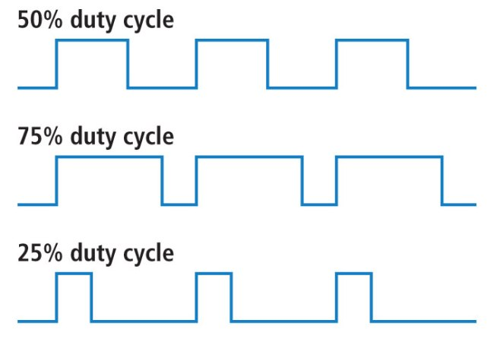
Duty cycle of a waveform
Defines the % of time the waveform is in ON state in one cycle time period (100%).
One cycle time period

Slide 98
Data transfer through ports: Example 3
Write an 8051 ALP to generate a square wave of 30% duty cycle on bit 0 of port 2. Assume that the time period of 1-cycle = 436μs
Solution:
Therefore, we toggle (complement) P2.0 with a time delay in between each state such that the ON time is 30% of each cycle.
BACK: SETB P2.0 ;complement P2.0
ACALL DELAY_ON ;calling delay program to create ON-time delay (30% of the total cycle time).
CPL P2.0
ACALL DELAY_OFF ;calling delay program to create OFF-time delay.
SJMP BACK
DELAY_ON: MOV R4,#----
HERE: DJNZ R4,HERE
RET
DELAY_OFF: MOV R5,#----
HERE2: DJNZ R5,HERE2
RET

Slide 99
Data transfer through ports: Example 4 (Byte addressing)
A program is written below to send complemented data AAH and 55H continually on PORT-3 (all 8-bits P3.0-P3.7). A finite delay is assumed between each complemented data. Byte addressing means, all the 8-bits of port-3 will be accessed by referring P3.
We have to send all 0’s to P3 initially since all ports are input ports by default.
MOV A,#00H ;A=00H; hexa decimal (all 0’s)
MOV P3,A ;make P3 an o/p port by writing it all 0s
BACK: MOV A,#0AAH ;A=AAH; hexa decimal
MOV P3,A ;send the contents of A-register in to Port-3
ACALL DELAY ; Calling delay program (routine)
MOV A,#55H ;A=55H; hexa decimal
MOV P3,A ;send the contents of A-register in to Port-3
ACALL DELAY ; Calling delay program (routine)
SJMP BACK
---time delay program-------
DELAY: MOV R4,#200 ; 200 is a decimal number. Its hexa decimal equivalent will be saved in R4.
HERE: DJNZ R4,HERE ; Decrement R4 and remain here till it becomes ZERO.
RET

Slide 100
Data transfer through ports: Example 5
Assume that bit P2.3 is an input and represents the condition of an oven. If it goes high, it means that the oven is hot. Monitor the bit continuously. Whenever it goes high, send a high-to-low pulse to port P1.5 to turn on a buzzer.
Solution:
HERE: JNB P2.3,HERE ;keep monitoring for high
SETB P1.5 set bit P1.5=1
CLR P1.5 ;make high-to-low
SJMP HERE ;keep repeating

Slide 101
Data transfer through ports: Example 6
A switch is connected to pin P1.7. Write a program to check the status of SW and perform the following:
(a) If SW=0, send letter ‘N’ to P2
(b) If SW=1, send letter ‘Y’ to P2
Use the carry flag to check the switch status.
Solution:
SETB P1.7 ;make P1.7 an input
AGAIN: MOV C,P1.7 ;read SW status into carry flag (C)
JC OVER ;jump if SW=1
MOV P2,#’N’ ;SW=0, issue ‘N’ to P2
SJMP AGAIN ;keep monitoring
OVER: MOV P2,#’Y’ ;SW=1, issue ‘Y’ to P2
SJMP AGAIN ;keep monitoring

Slide 102
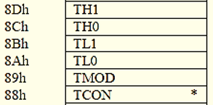
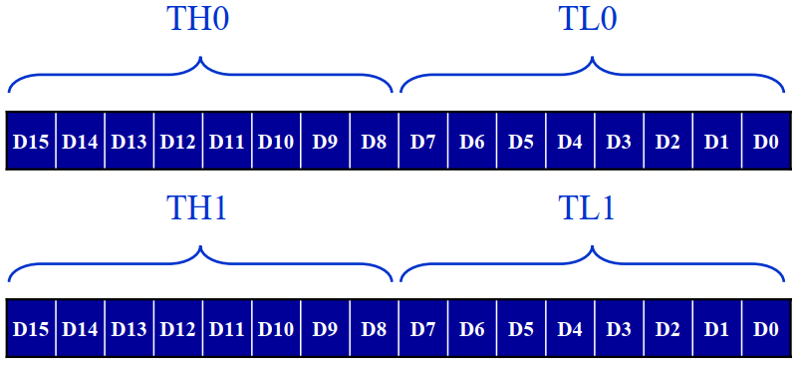
Timers-Counters in 8051 µC
In Intel 8051, there are two 16-bit timer registers. These registers are known as Timer-0 and Timer-1.
The same timer registers can be used as Timer as well as Counter.
The only difference between timer and counter operation is the source for incrementing the timer registers.
Both Timer 0 and Timer 1 are 16 bits wide. Since 8051 has an 8-bit architecture, each
16-bits timer is accessed as two separate registers of low byte (TLx) and high byte
(THx). These are accommodated in SFR memory area as shown here.
Timer/counter registers can be Accessed as follows,
MOV TL0,#4FH
MOV R5,TH0
TCON and TMOD registers are used for timer/counter control and mode selection.
Timer/Counter-0 looks like this
as a 16-bit register.

Slide 103
Timers-Counters in 8051 µC
The only difference between timer and counter operation is the source for incrementing the timer registers.
Timer operation
In the timer mode, the internal machine cycles are counted. So the timer is increments in each machine cycle.
Which means, the timer operating frequency is equal to machine cycle frequency i.e. (1/12) of XTAL (clock) frequency.
Counter operation
In the counter mode, the external events are counted. Here, the timer/counter register will be incremented for each 1 to 0 transition of the external input pin T0 (for counter-0) and T1 (for counter-1). These type of transitions are treated as events.
The external input pins are sampled once in each machine cycle, and to determine the 1or 0 transitions, another machine cycle will be needed.
So in counter mode, at least two machine cycles are needed to increment the counter. Hence the maximum operating frequency of counter is equal to (1/24) of XTAL (clock) frequency.
The maximum frequency of counter can be varied with XTAL (Crystal oscillator) frequency.

Slide 104
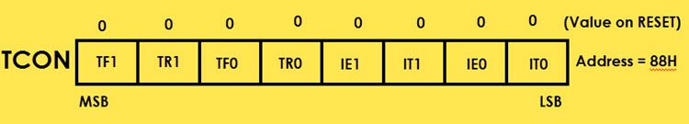
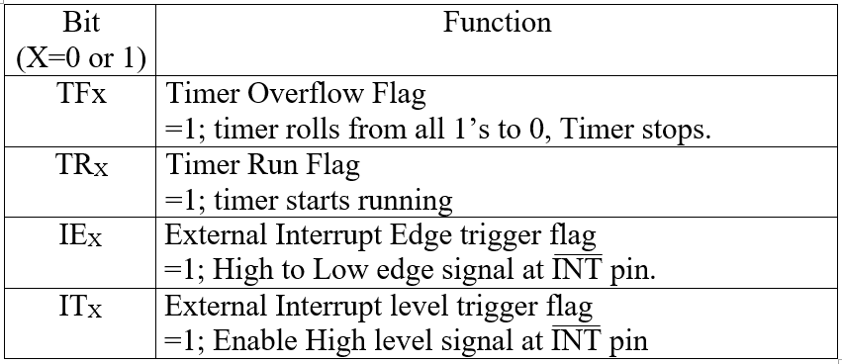
Timers-Counters in 8051 µC – Format of TCON register
TCON (Timer Control) is an SFR. The address of this register is 88H. This is bit-addressable.

Slide 105
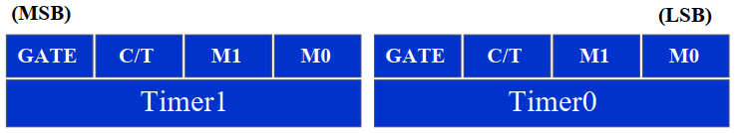
Timers-Counters in 8051 µC – Format of TMOD register
TMOD (Timer Mode) is an SFR. The address of this register is 89H. This is not bit-addressable.
Bit Details | High Value (1) | Low Value (0)
C/T’ | Configure for the Counter operations | Configure for the Timer operations
Gate (G) | Timer0 or Timer1 will be in RunMode when TR_{X} bit of TCON register is high. | Timer0 or Timer1 will be in RunMode when TR_{X} bit of TCON register is high and INT0 or INT1 is high.
M1 M0 | 00 (Mode-0) | 01 (Mode-1) | 10 (Mode-2) | 11 (Mode-3)
 | 8-bit timer/counter, with 5-bit pre-scaler. (Total 13-bits in use) | 16-bit timer/counter | 8-bit auto reload timer/counter; THx holds a value which is to be reloaded into TLx each time it overflows. | Split mode, Timer split in to two separate 8-bit timers.

Slide 106
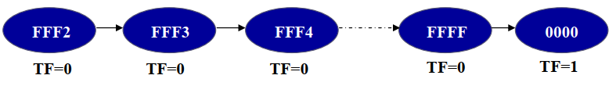
Timers-Counters in 8051 µC – Generating delay using Timers
DELAY generated by timer=(Max.value –Initial value+1)*(Time period of one machine cycle)
max. value = maximum count value a timer/counter can reach (based on selected mode in TMOD register)
Initial value= the value we need to load into timer to the get the required delay.
+1 is required in the above equation as timer increments one more time (to roll over to Zero) after reaching its maximum value. After rollover, the timer will stop and TF (timer overflow) flog in TCON (Timer control) register is Set. For example, see below.
NOTE: 8051 timers works at a rate of 1/12 of the CLK (XTAL) frequency (equal to machine cycle frequency).
If XTAL frequency is 11.0592MHz, then the delay required/generated for each count (pulse) is as follows,
(11.0592MHz/12)=926kHz=1.085µsec

Slide 107
Generating delay using Timers- Example program-1
Find the delay generated by timer 0 in the following code. Do not include the overhead due to instructions.
ORG 0H
CLR P2.3 ;Clear P2.3
MOV TMOD,#01 ;Timer 0, 16-bit mode (mode-1) is selected
BACK: MOV TL0,#3EH ;TL0=0, the low byte
MOV TH0,#0B8H ;TH0=0, the high byte
CPL P2.3 ;Complement P2.3
SETB TR0 ;Start timer 0
AGAIN: JNB TF0,AGAIN ;Monitor TF0
CLR TR0 ;Stop the timer 0
CLR TF0 ;Clear TF0 flag
SJMP BACK
END
Loading TMOS for mode selection
Loading initial value.
By default, operating frequency of the timer is same as machine cycle frequency as it is counting the machine cycles to generate delay. So, the delay generated by the timer for each tick is equal to the time period of the machine cycle.
Start timer-0
Wait till timer-0 stops (overflow)
Clear TR and TF as the timer created required delay.
Solution: Assume, XTAL frequency is 11.0592MHz. Then, time period of one machine cycle is 1.085µs. (FFFFH – B83E + 1) = 47C2H (18370 in decimal)
18370 × 1.085 µs = 19.93145 ms

Slide 108
Generating delay using Timers- Example program-2
In the following program, Calculate the frequency of the square wave generated on pin P1.5. Assume XTAL frequency is 22MHz. Also consider the delay caused by instruction overhead.
Machine Cycles
MOV TMOD,#01H
HERE: MOV TL0,#0F2H 2
MOV TH0,#0FFH 2
CPL P1.5 1
ACALL DELAY 2
SJMP HERE 2
DELAY:
SETB TR0 1
AGAIN: JNB TF0,AGAIN 14
CLR TR0 1
CLR TF0 1
RET 2
Total= 28 machine cycles.
Since it is asked to consider the instruction overhead (time delay caused by the execution of the instructions), we need to add this delay with timer generated delay for frequency calculation.
By default, operating frequency of the timer is same as machine cycle frequency as it is counting the machine cycles to generate delay. So, the delay generated by the timer for each tick is equal to the time period of the machine cycle.
Timer runs for 14 steps to reach overflow/roll over, as it’s initial value is FFF2H.
Max. FFFFH + 1 for roll over
Solution
To get a more accurate timing, we need to add the clock cycles due to the other instructions in the loop (along with the clock cycles taken by timer).
Note: XTAL frequency is given as 22MHz to calculate the time period of one machine cycle.

Slide 109
Generating delay using Timers- Example program-2
Solution:
To get a more accurate timing, we need to add the clock cycles due to the other instructions in the loop (along with the clock cycles taken by timer).
Note: XTAL frequency is given as 22MHz to calculate the time period of one machine cycle.
T = 2 × 28 × 0.545 µs = 30.52 µs and f = 32.765 kHz
DELAY generated by timer=(Max.value –Initial value+1)*(Time period of one machine cycle)

Slide 110
Generating delay using Timers- Example program-3
Assume that XTAL = 12 MHz, write a program to generate a square wave of 2 kHz frequency on pin P1.5. Use timer-1 in appropriate mode.
DELAY generated by timer=(Max.value –Initial value+1)*(Time period of one machine cycle)

Slide 111
Generating delay using Timers- Example program-3
Solution:
Except that we must toggle the bit to generate the square wave. Look at the following steps.
(a) T = 1 / f = 1 / 2 kHz = 500 us ;the period of square wave.
(b) 1 / 2 of it is the high and low portion of the square wave (one cycle) which is 250 us.
(c) Select mode-1 for getting maximum possible delay.
(c) 250 us / 1 us = 250 and 65535 – 250 +1= 65286 which is equal to FF06H in hexa.
(d) TL1 = 06H and TH1 = FFH, The program is as follow.
MOV TMOD,#10H ;Timer 1, 16-bit mode
AGAIN: MOV TL1,#06H ;TL1=06, load lower byte of timer
MOV TH1,#0FFH ;TH1=FF, load the higher byte of timer
SETB TR1 ;Start timer-1
BACK: JNB TF1,BACK ;wait until timer rolls over
CLR TR1 ;Stop the timer 1
CPL P1.5 ;COMPLEMENT P1.5
CLR TF1 ;Clear timer 1 flag
SJMP AGAIN ;Reload timer
FFFFH = 65535 in decimal.

Slide 112
Generating delay using Timers- Example program-4 (mode-2 auto reload)
Assume XTAL = 11.0592 MHz, find the frequency of the square wave generated on pin P1.0 in the following program.
MOV TMOD,#20H ;T1/8-bit/auto reload
MOV TH1,#05H ;TH1= 5 (will be auto reloaded in to TL1 and TL1 works as timer)
SETB TR1 ;start the timer 1
BACK: JNB TF1,BACK ;till timer rolls over
CPL P1.0 ; complement P1.0
CLR TF1 ;clear TF1 flag
SJMP BACK ;Jump back and auto-reload initial value in to TL1
Solution:
First, notice the point to which we are going back from SJMP. We are not loading initial value again. In mode 2 we do not need to reload TH with initial value always since it is auto-reload.
Now, (255-5+1) × 1.085 µs =251 × 1.085 µs = 272.33 µs. This is the delay for one iteration which means for ON or OFF of square wave. Since The time period (T) of square wave is twice of that; as a result T = 2 × 272.33 us = 544.67 µs and the frequency =1.83597 kHz
In auto reload mode, timer works with 8-bit capacity. So, maximum value is FFH (255 in decimal).

Slide 113
Generating delay using Timers- Example program-5 (mode-2 auto reload)
Find (a) the frequency of the square wave generated in the following code, and (b) the duty cycle of this wave.
MOV TMOD,#2H ;Timer 0, mode 2 (8-bit, auto-reload)
MOV TH0,#-150 ;TH0 = 6AH = 2's Complement of -150
AGAIN: SETB P1.3 ; Pl.3 = 1
ACALL DELAY ; Delay called twice
ACALL DELAY
CLR P1.3 ; Pl.3=0
ACALL DELAY ; Delay called once
SJMP AGAIN
DELAY:
SETB TR0 ;start Timer 0
BACK : JNB TF0,BACK ;stay until timer rolls over
CLR TF0 ;clear TF for next round
RET
In auto reload mode, timer works with 8-bit capacity. So, maximum value is FFH (255 in decimal).
Since it is not asked to consider the instruction overhead (time delay caused by the execution of the instructions), we can ignore it for frequency calculation. Consider only timer generated delay.

Slide 114
Generating delay using Timers- Example program-5 (mode-2 auto reload)
Solution:
Here, a negative value is loaded in to TH as an initial value. This negative number will be converted in to its 2’s complement form by the assembler. So, the 2,s complement of the -150 i.e. 6A will be loaded in to TH which will be auto loaded in to TL (mode-2).
150 (decimal)= 96H. Since -150 is given, find the 2,s complement for 96H as shown below.
96H= 1001 0110
0110 1001 1’s complement
+1
6AH=0110 1010 2’s complement representation of -150. So, 6AH will be loaded in to TH.
Duty cycle calculation:
Here, the delay is called twice for ON period (SETB P1.3). Hence the logic high level of the square wave at P1.3 is twice that of the low portion. Which means ~66% duty cycle.
Frequency calculation:
Delay= (FF-6A+1)x1.085µs=162.75µs. Since, delay is called twice during ON period, T_{ON}=325.5µs. Delay is called once for OFF period, T_{OFF}=162.75µs. T_{total}=325.5µs+162.75µs=488.25µs.
Frequency = (1/T_{total})=1/488.25µs = 2.048 kHz.

Slide 115
Programming with Counters- Example program
Assuming that external clock pulses are fed into pin T1, write a program for counter 1 in mode 2 to count the pulses and display the TL1 count on P2, which connects to 8 LEDs.
Solution:
MOV TMOD,#01100000B ;counter 1, mode 2 (8-bit auto reload.); C/T’=1
MOV TH1,#0 ;clear TH1 (will be auto reloaded in to TL1 and TL1 starts counting)
SETB P3.5 ;make T1 pin as input
AGAIN: SETB TR1 ;start the counter
BACK: MOV A,TL1 ;get copy of TL
MOV P2,A ;display it on port 2
JNB TF1, BACK ;keep doing, if TF ≠ 1 (no over flow/roll over)
CLR TR1 ;stop the counter 1
CLR TF1 ;make TF=0
SJMP AGAIN ;keep doing it
Notice in the above program, the role of the instruction SETB P3.5. We make T1 pin (pin P3.5) an input port by making it high.
In auto reload mode, counter works with 8-bit capacity. So, maximum value is FFH (255 in decimal).

Slide 116
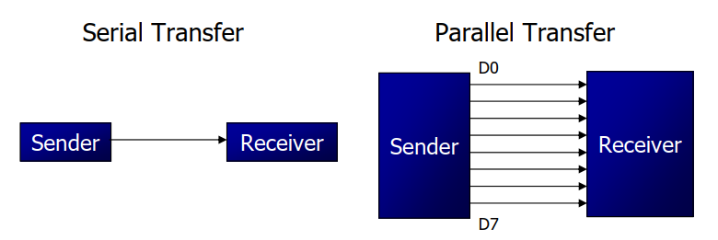
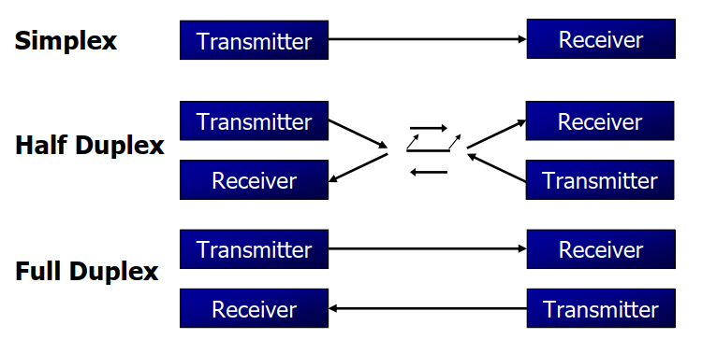
SERIAL COMMUNICATION in 8051
Types of serial communication based on direction of data transfer.

Slide 117
SERIAL COMMUNICATION in 8051
Serial data communication uses two methods
Synchronous method transfers a block of data at a time
Asynchronous method transfers a single byte at a time
There are special IC chips made by many manufacturers for serial communications.
 UART (universal asynchronous Receiver-transmitter)
 USRT (universal synchronous Receiver-transmitter)
8051 supports asynchronous serial communication since it is provided with on-chip UART.
There are two 8051 pins namely TXD (P3.1) and RXD (P3.0), used for transmitting and receiving serial data bits.
There are two dedicated registers available in 8051 for serial communication. They are Serial Buffer register (SBUF) and Serial Control register (SCON). Both are accommodated in SFR memory area.
SBUF is a shift register which is used to store the received data bits in serial communication. Same register can be used to hold the data bets to transmit them serially.
SCON register is used to control the serial communication. E will see the format of SCON register in coming slides.

Slide 118
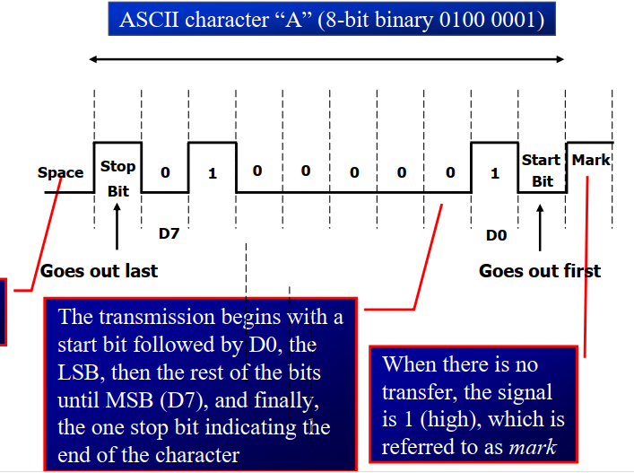

SERIAL COMMUNICATION in 8051-Asynchronous- data frame

Slide 119
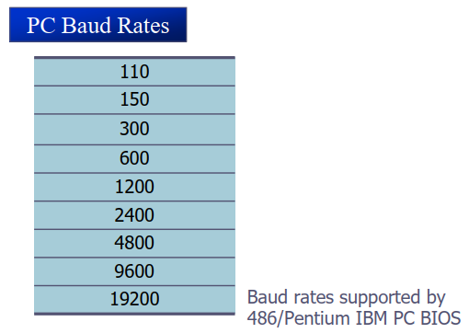
SERIAL COMMUNICATION in 8051-Asynchronous- Baud rate
Baud rate defines the rate at which serial communication is happening.
Baud rate means number of characters received/transmitted per second.

Slide 120
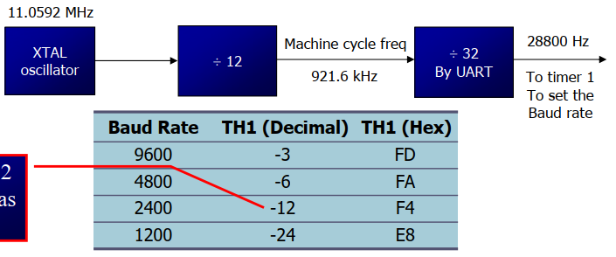
SERIAL COMMUNICATION in 8051-Asynchronous- How to select required Baud rate
The list of supported baud rates by 8051 microcontroller is given bellow.
Default frequency of
serial communication. (upon RESET)
Baud rate
9600
4800
2400
1200
Timer-1 Mode-2 to set the Baud rate
These baud rates can be derived from the default serial communication frequency of 8051.
The default serial communication frequency is the (1/32) of machine cycle frequency (which is 1/12 of XTAL frequency).
The default serial communication frequency (28800 Hz here) will be divided with a factor to get the required baud rate. The 2’s complement of division factor will be loaded in to Timer-1 in Mode-2.
For the considered XTAL frequency of 11.0592MHz, default frequency is 28800 Hz.
Baud rate | 9600 | 4800 | 2400 | 1200
Division factor | 3 (28800/3=9600) | 6 (28800/6=4800) | 12 (28800/12=2400) | 24 (28800/24=1200)

Slide 121
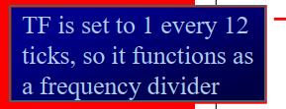
SERIAL COMMUNICATION in 8051-Asynchronous – Baud rate selection with Timer-1 Mode-2
The bellow table shows the 2’s complement representations of division factors for respective baud rates.
The 2’s complement values will be loaded in to TH1 of Timer-1 since it is in Mode-2 (8-bit auto reload mode.)
Then the timer divides the default serial communication frequency with loaded factor and generate the required baud rate.
In Mode-2. higher byte of timer will be loaded with initial value, which will be then auto loaded in to TL1 (lower byte). Now, TL1 start acting as the timer.
For the considered XTAL frequency of 11.0592MHz, default serial communication frequency is 28800 Hz.

Slide 122
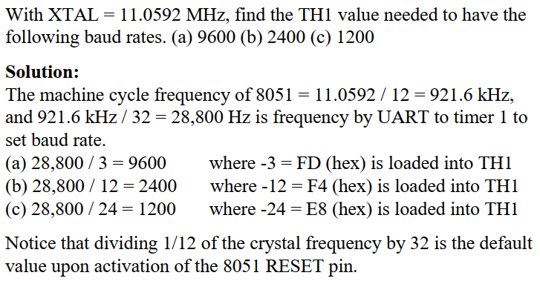
SERIAL COMMUNICATION in 8051-Asynchronous-Baud rate selection with Timer-1 Mode-2
Why loading 2’s complement: For example, when timer is loaded with 2’s complement of the factor 3 i.e. FD H, it will take exactly 3 steps to reach overflow (roll over). After overflow, timer will divide the default frequency i.e. 28800 with 3 to get 9600 baud.

Slide 123
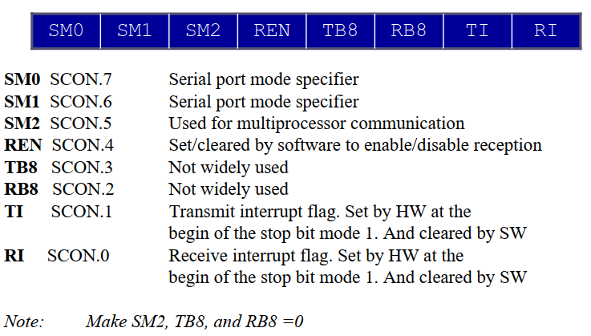
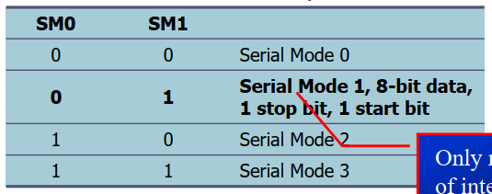

SERIAL COMMUNICATION in 8051- SCON Register format
Serial Control (SCON) Register
SM0 SM1
1 0 Mode-2
This mode send/receive data between multiprocessors. (environment where communication between multiple 8051 processors is required.)
Mode-0 and 3 are used to choose frame length with 9-data bits (old method).

Slide 124
SERIAL COMMUNICATION in 8051-Asynchronous – Serial Transmission -example program 1
Write a program for the 8051 to transfer letter ‘A’ serially at 4800 baud, continuously.
Solution:
MOV TMOD,#20H ;timer 1,mode 2(auto reload)
MOV TH1,#-6 ;4800 baud rate
CLR P3.1 ; making TXD pin as output port
MOV SCON,#50H ;8-bit, 1 stop, REN enabled
SETB TR1 ;start timer 1
AGAIN: MOV SBUF,#'A' ;letter ‘A’ to transfer
HERE: JNB TI,HERE ;wait for the last bit
CLR TI ;clear TI for sending next byte
SJMP AGAIN ;keep sending A
END
{2’s complement of -6 that is FA H will be loaded in to TH1 as a division factor to get 4800 baud rate (28800/6=4800).}
From FA H, timer will take 6 steps to reach overflow (roll over). Then it will divide the default value i.e. 28800 with 6 to get 4800 baud.

Slide 125
SERIAL COMMUNICATION in 8051-Asynchronous – Serial Transmission -example program 2
Write a program for the 8051 to transfer “YES” serially at 9600 baud, 8-bit data, 1 stop bit, do this continuously
Solution:
MOV TMOD,#20H ;timer 1,mode 2(auto reload)
MOV TH1,#-3 ;9600 baud rate
MOV SCON,#50H ;Mode-1 (8-bit, 1 stop), REN enabled
SETB TR1 ;start timer 1
AGAIN: MOV A,#'Y' ;transfer 'Y'
ACALL TRANS
MOV A,#'E' ;transfer 'E'
ACALL TRANS
MOV A,#'S' ;transfer 'S'
ACALL TRANS
SJMP AGAIN ;keep doing it
;serial data transfer subroutine (sub program, will be called from the main program when ever required)
TRANS: MOV SBUF,A ;load SBUF
HERE: JNB TI,HERE ;wait for the last bit transmission (transmit interrupt TI=1)
CLR TI ;get ready for sending next byte after clearing TI
RET
{2’s complement of -3 that is FD H will be loaded in to TH1 as a division factor to get 9600 baud rate (28800/3=9600).}
Since SBUF is an 8-bit register, it can hold one character (8-bit ASCII) at a time. So, SBUF need to be loaded with first character and reload with another character after sending previous character.
From FD H, timer will take 3 steps to reach overflow (roll over). Then it will divide the default value i.e. 28800 with 3 to get 9600 baud.

Slide 126
SERIAL COMMUNICATION in 8051-Asynchronous – Serial Transmission -example program 3
Write an 8051 assembly program to transfer data serially at baud rate 9600 with 8 bit data, one stop bit and observe the transmitted data in the serial window of the simulator.
Solution:
ORG 0000H
XX: MOV DPTR, #MYDATA
MOV TMOD, #20H
MOV TH1, #-3
MOV SCON, #50H
SETB TR1
MOV R1, #14
AGAIN: CLR A
MOVC A,@A+DPTR
MOV SBUF, A
HERE: JNB TI, HERE
CLR TI
INC DPTR
DJNZ R1, AGAIN
SJMP XX
;-----string saved in the memory-----
MYDATA: DB 'VIT UNIVERSITY'
END
2’s complement of -3 that is FD H will be loaded in to TH1 as a division factor to get 9600 baud rate (28800/3=9600). From FD H, timer will take 3 steps to reach overflow (roll over). Then it will divide the default value i.e. 28800 with 3 to get 9600 baud.
In this program, a string “VIT UNIVERSITY” is saved in the ROM (code memory).
MYDATA is the label which represents the starting address of the string where it is saved in the memory.
Since each character in the string will be saved as its equivalent ASCII code (8-bits), each character occupies one memory location after saving it in the memory. So, each memory location and hence each character have an unique memory address.
This address need to be copied in to DPTR register first. Then the content (character) in the memory location whose address is pointed by DPTR will be passed in to Accumulator (A) register. Then from A-register, it will be sent to SBUF for serial transmission.
We have to follow the same process for all characters to sent. After sending each character, Transmit interrupt (TI) bit of SCON register will be set which indicates the successful transmetion of one character.
A counter (R1-register) which represents (loaded with) string length will be decremented after sending each character of the string..
SBUF need to be loaded with first character and reload with another character after sending previous character. (SBUF is an 8-bit register, it can hold one character (8-bit ASCII) at a time.)

Slide 127
SERIAL COMMUNICATION in 8051-Asynchronous – Serial Reception -example program 4
Write a program for the 8051 to receive bytes of data serially, and put them in P1, set the baud rate at 4800, 8-bit data, and 1 stop bit
Solution:
MOV TMOD,#20H ;timer 1,mode 2(auto reload)
MOV TH1,#-6 ;4800 baud rate
MOV SCON,#50H ;8-bit, 1 stop, REN enabled
SETB TR1 ;start timer 1
HERE: JNB RI,HERE ;wait for the last bit to receive (receive interrupt RI=1)
MOV A,SBUF ;saving incoming byte in A
MOV P1,A ;send to port 1
CLR RI ;get ready to receive next byte after clearing RI
SJMP HERE ;go back and receive the next byte.
{2’s complement of -6 that is FA H will be loaded in to TH1 as a division factor to get 4800 baud rate (28800/6=4800).}
From FA H, timer will take 6 steps to reach overflow (roll over). Then it will divide the default value i.e. 28800 with 6 to get 4800 baud.

Slide 128
Power control register (PCON) of 8051
SMOD | X | X | X | GF1 | GF0 | PD | IDL
Unused bits
PCON is an 8-bit special function register (SFR) accommodated in SFR memory area with an address 87H. It is not bit addressable.
SMOD
This bit if set (1), it will double the baud rate of serial communication.
GF0 and GF1: These are general purpose flag bits.
Idle mode
When IDL bit of the PCON register is set, the microcontroller turns off the CPU unit while peripheral units such as serial port, timers and interrupt system continue operating normally.
In Idle mode, the state of all registers and I/O ports remains unchanged.
To exit the Idle mode, it is necessary to enable and execute any interrupt or reset.
It is recommended that, first three instructions to be executed after coming out of Idle mode are NOP instructions to stabilize the microcontroller and prevents undesired changes on the I/O ports.

Slide 129
Power control register (PCON) of 8051
Power down mode
By setting the PD bit of the PCON register within the program, the microcontroller enter in to Power down mode.
Internal oscillator will be turned off and reduces power consumption.
The microcontroller can operate using only 2V power supply in power- down mode.
The only way to get the micro controller back to normal mode is by reset.
While the microcontroller is in Power Down mode, the state of all SFR registers and I/O ports remains unchanged.
By setting it back into the normal mode, the contents of the SFR register is lost, but the content of internal RAM is saved.
Reset signal must be long enough, approximately 10ms, to enable stable operation of the crystal oscillator.

Slide 130
Interrupts in 8051
An interrupt is an external or internal event that interrupts the microcontroller to inform it that a device needs its service
A microcontroller can serve several devices by two ways
Interrupts
Whenever any device (peripheral) needs its service, the device notifies the microcontroller by sending it an interrupt signal.
Upon receiving an interrupt signal, the microcontroller interrupts whatever it is doing and serves the device.
Polling (old approach/outdated)
The microcontroller continuously monitors the status of a connected device (peripheral).
When the conditions met, it performs the service.
After that, it moves on to monitor the next device until every one is serviced.
Due to this, significant amount of microprocessor’ time will be wasted since the microprocessor is visiting all the peripherals with out knowing the requirement of peripheral.

Slide 131
Types of Interrupts in 8051
Six interrupts are allocated in 8051, as follows;
Reset : power-up reset
Two interrupts are set aside for the timers: one for timer-0 overflow (TF0) and one more for timer-1 overflow (TF1).
Two interrupts are set aside for hardware external interrupts
Pins P3.2 and P3.3 have dual functionality for the external hardware interrupts INT0 (EX0)
and INT1 (EX1).
Serial communication has a single interrupt that belongs to both receive (receive interrupt (RI)) and transfer (transmit interrupt (TI)).

Slide 132
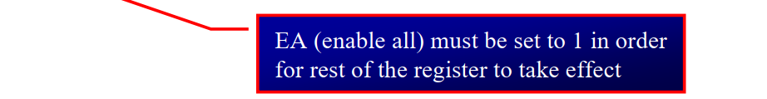
Enable/disable Interrupts in 8051
Upon reset, all interrupts are disabled (masked), meaning that none will be responded to by the microcontroller if they are invoked.
There is a register called IE (interrupt enable) that is responsible for enabling (unmasking) and disabling (masking) the interrupts.
IE register is accommodated in SFR memory area.
D7
D0
EA | -- | ET2 | ES | ET1 | EX1 | ET0 | EX0
If EA = 1, interrupts are enabled and will be responded to, if their corresponding bits in IE register are high;
If EA = 0, no interrupt will be responded to, even if the associated bit in the IE register is high.

Slide 133
Enable/disable Interrupts in 8051
Pin 12 (P3.2) and pin 13 (P3.3) of the 8051, designated as INT0 and INT1, are used as external hardware interrupts
There are two activation levels for the external hardware interrupts (INT0 and INT1).
Level trigged - In the level-triggered mode, INT0 and INT1 pins are normally high. So,
If a low-level signal is applied to them, it triggers the interrupt.
Edge trigged – Set IE0/IE1 bit (TCON.1/TCON.3) to enable edge triggering for INT0/INT1

Slide 134
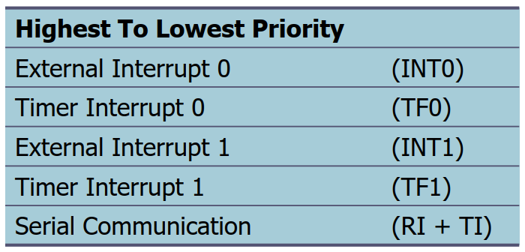
8051-Interrupt Priority Upon Reset

Slide 135
8051- Modifying the default Interrupt Priority Interrupt Priority (IP) Register (Bit-addressable)
D7
D0
-- | -- | PT2 | PS | PT1 | PX1 | PT0 | PX0
Priority bit=1 assigns high priority
Priority bit=0 assigns low priority
In the 8051, a low-priority interrupt can be interrupted by a higher-priority Interrupt.
But it prohibits the interruption of higher-priority Interrupt by using another low-priority interrupt.

Slide 136
Interrupt service routine - Interrupt Vector Table
interrupt service routines (ISR) or interrupt handler is a pre-written program which defines the service for an interrupt request.
Each interrupt request have its own ISR. All these ISRs will be stored in the memory and the addresses of the starting memory locations of these ISRs will be updated in to interrupt vector table.
Interrupt vector table is an index of memory addresses where, the starting address of the interrupt service routines (ISRs) are saved.
When an interrupt request comes, microcontroller search the interrupt vector table to find the address of the starting memory location of the required ISR.
So that, corresponding ISR will be executed to serve the interrupt request.

Slide 137
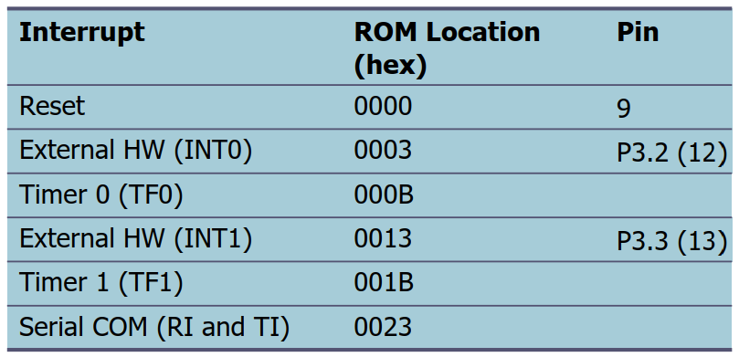
Interrupt Vector Table of 8051 µC

Slide 138
Programming using Interrupts-Example1
Discuss what happens if interrupts INT0, TF0, and INT1 are activated at the same time. Assume priority levels were set by the power-up reset and the external hardware interrupts are edge triggered.
Solution:
priority levels were set by the power-up reset means default priority levels.
If these three interrupts are activated at the same time, their statuses are saved internally. Then the 8051 checks all five interrupts according to the sequence listed in the default priority order. If any is activated, it services it in sequence.
Therefore, when the above three interrupts are activated, INT0 (external interrupt- IE0) is serviced first, then timer 0 (TF0), and finally INT1 (external interrupt- E1).

Slide 139
Programming using Interrupts-Example2
(a) Program the IP register to assign the highest priority to INT1(external interrupt 1), then
(b) discuss what happens if INT0, INT1, and TF0 are activated at the same time. Assume the interrupts are edge-triggered.
Solution:
(a) MOV IP,#00000100B ;IP.2=1 assign INT1 higher priority. The instruction SETB IP.2 also will do the same thing as the above line since IP is bit-addressable.
(b) The instruction in Step (a) assigned a higher priority to INT1 than the others; therefore, when INT0, INT1, and TF0 interrupts are activated at the same time, the 8051 services INT1 first, then it services INT0, then TF0.
The instruction in Step (a) makes both the INT0 and TF0 bits in the IP register 0. As a result, the sequence in default priority order is followed which gives a higher priority to INT0 over TF0.

Slide 140
Programming using Interrupts-Example3
Assume that after reset, the interrupt priority is set by the instruction MOV IP,#00001100B. Discuss the sequence in which the interrupts are serviced.
Solution:
The instruction “MOV IP #00001100B” (B is for binary) assigned INT1 and timer 1 (TF1) to a higher priority level compared with the rest of the interrupts. However, INT1 and timer 1 (TF1) both are set, they are prioritized as per the default priority order (INT1 gets highest priority and TF1 gets second priority). The priorities of the remaining interrupts are rearranged by following the default priority order.
Finally, the updated priorities are as follows.
External Interrupt 1 (INT1) : Highest Priority
Timer Interrupt 1 (TF1) : Second Priority
External Interrupt 0 (INT0) : rearranged as per default.
Timer Interrupt 0 (TF0) : rearranged as per default.
Lowest Priority Serial Communication (RI+TI) : rearranged as per default.
Interrupt priority (IP) register:
D7
D0
-- | -- | PT2 | PS | PT1 | PX1 | PT0 | PX0

Slide 141
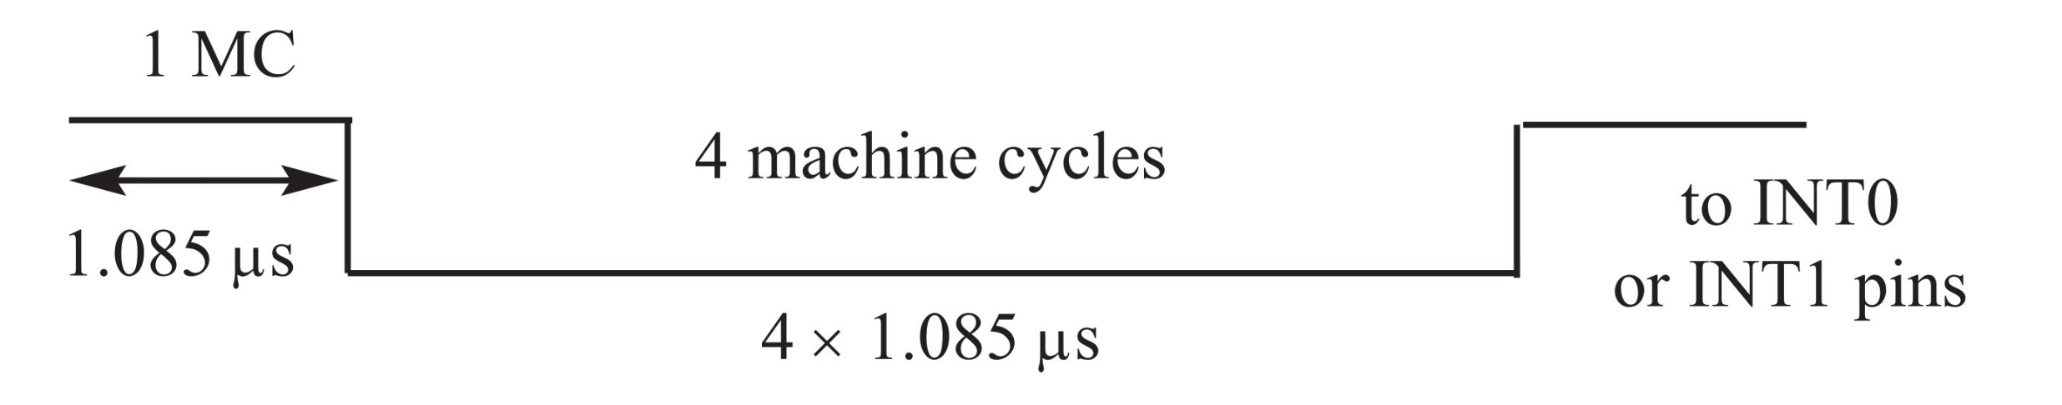
Level triggering/Edge triggering of External Interrupts- INT0 and INT1
Low-level triggering:
On RESET, IT0 (TCON.0) and IT1 (TCON.2) are both low, making external interrupts (INT0 and INT1) low-level triggered by default.
Minimum Duration of the low level required to consider the Low Level-Triggered Interrupt is 4-machine cycles. (1 machine cycle=1.085µs if XTAL = 11.0592 MHz)
(if XTAL = 11.0592 MHz)

Slide 142

Level triggering/Edge triggering of External Interrupts- INT0 and INT1
Falling-edge triggering:
Can be enabled by setting IE0/IE1 (TCON.1/TCON.3); making external interrupts (INT0/INT1) falling-edge triggered.
Falling edge (negative edge)

Slide 143
Programming using Interrupts-Example4
Assuming that pin 3.3 (INT1) is connected to a pulse generator, write a program in which the falling edge of the pulse will send a high to P1.3, which is connected to an LED (or buzzer). In other words, the LED is turned on and off at the same rate as the pulses are applied to the INT1 pin.
Solution:
ORG 0000H
LJMP MAIN
;--ISR for hardware interrupt INT1 to turn on the LED
ORG 0013H ;INT1 ISR vector address
SETB P1.3 ;turn on the LED
MOV R3,#55
BACK:DJNZ R3,BACK ;keep the LED on for a while
CLR P1.3 ;turn off the LED
RETI ;return from ISR to main program
;--MAIN program for initialization
ORG 30H
MAIN: SETB TCON.3 ;make INT1 edge-trigger interrupt using TCON register
MOV IE,#10000100B ;enable External INT1 using IE register
HERE: SJMP HERE ;stay here until interrupted
END
IE register format
EA | -- | ET2 | ES | ET1 | EX1 | ET0 | EX0
Interrupt vector table

Slide 144
Programming using Interrupts-Example5 page1
Write a program that continuously gets 8-bit data from P0 and sends it to P1 while simultaneously creating a square wave of 200 µs period on pin P2.1. Use Timer 0 to create the square wave. Assume that XTAL = 11.0592 MHz.
Solution:
;—-Upon wake-up go to main program.
ORG 0000H
LJMP MAIN ;bypass interrupt vector table
;—-ISR for Timer 0 to generate square wave
ORG 000BH ;Timer 0 overflow interrupt vector address
CPL P2.1 ;toggle P2.1 pin
RETI ;return from ISR to main program
;—-The main program for initialization
ORG 0030H
MAIN: MOV TMOD,#02H ;Timer 0, mode 2(auto-reload)
MOV P0,#0FFH ;make P0 an input port
MOV TH0,#-92 ;TH0=6EH for -92. (it will generate 100µs delay)
MOV IE,#82H ;IE=10000010 (binary) enable Timer 0 interrupt
SETB TR0 ;Start Timer 0
Interrupt vector table
IE register format
EA | -- | ET2 | ES | ET1 | EX1 | ET0 | EX0

Slide 145
Programming using Interrupts-Example5 page2
Write a program that continuously gets 8-bit data from P0 and sends it to P1 while simultaneously creating a square wave of 200 µs period on pin P2.1. Use Timer 0 to create the square wave. Assume that XTAL = 11.0592 MHz.
Solution:
BACK: MOV A,P0 ;get data from P0
MOV P1,#00H ; make P1 as output port
MOV P1,A ;issue it to P1
SJMP BACK ;keep doing it; loop unless interrupted by TF0
END

Slide 146
Programming using Interrupts-Example6 Page1
Write a program using interrupts to do the following:
(a) Receive data serially and sent it to P0,
(b) Have P1 port read and transmitted serially, and a copy given to P2,
(c) Make timer 0 generate a square wave of 5kHz frequency on P0.1.
Assume that XTAL 11.0592MHz. Set the baud rate at 4800.
Solution:
ORG 0
LJMP MAIN
ORG 000BH ;ISR vector address for Timer-0 overflow Interrupt.
CPL P0.1 ;toggle P0.1; ISR for Timer-0 overflow Interrupt, runs when TF0=1.
RETI ;return from ISR to main program
ORG 0023H ;ISR vector address for serial com. Interrupt as show in above table.
LJMP SERIAL ;jump to serial interrupt ISR
ORG 30H
MAIN: MOV IE,10010010B ;enable timer overflow for timer-0, serial (RI/TI) interrupts.
;-------solving part-b of the question--------continuation to above code----------
MOV P1,#0FFH ;make P1 an input port
Interrupt vector table
IE register format
EA | -- | ET2 | ES | ET1 | EX1 | ET0 | EX0

Slide 147
Programming using Interrupts-Example6 Page2
Write a program using interrupts to do the following:
(a) Receive data serially and sent it to P0,
(b) Have P1 port read and transmitted serially, and a copy given to P2,
(c) Make timer 0 generate a square wave of 5kHz frequency on P0.1.
Assume that XTAL 11.0592MHz. Set the baud rate at 4800.
Solution:
MOV SCON,#50H ;8-bit data frame, 1 stop, REN enabled
MOV TMOD,#22H ;timer 0 and timer 1 in mode 2(auto reload)
MOV TH1,#-6H ;for 4800 baud rate, initial value for timer-1 mode-0
SETB TR1 ;start timer 1
BACK: MOV A,P1 ;read data from port 1
MOV SBUF,A ;give a copy to SBUF
MOV P2,A ;send it to P2
SJMP BACK ;stay in loop indefinitely
;-------solving part-c of the question--------continuation to above code----------
MOV TH0,#6EH ;initial value for delay of 100µs (1/200µs=5kHZ), already timer-0 in mode-2.
SETB TR0 ;start timer 0

Slide 148
Programming using Interrupts-Example6 page3
Write a program using interrupts to do the following:
(a) Receive data serially and sent it to P0,
(b) Have P1 port read and transmitted serially, and a copy given to P2,
(c) Make timer 0 generate a square wave of 5kHz frequency on P0.1.
Assume that XTAL 11.0592MHz. Set the baud rate at 4800.
Solution:
;-----SERIAL PORT ISR for solving part-a of the question------continuation to previous code---;----this part of the code will execute when ever TI/RI interrupts come.
ORG 100H
SERIAL:JB TI,TRANS ;jump if TI is high
MOV A,SBUF ;otherwise due to receive
MOV P0,A ;send serial data to P0
CLR RI ;clear RI since CPU doesn’t
RETI ;return from ISR
TRANS: CLR TI ;clear TI since CPU doesn’t
RETI ;return from ISR
END

